Slide 1
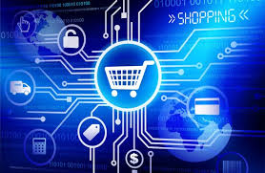
Digitalization and Consumers

Slide 2
Digitalization is the strategic use of digital technologies and digitized data to fundamentally transform business operations, processes, and business models, leading to increased efficiency, improved data management, and enhanced competitiveness

Slide 3
Impact of Digitalization on Consumers in Pakistan
How Digital Tools are Reshaping Pakistani Consumer Behavior

Slide 4
Introduction
Digitalization is driving Pakistan’s consumer market growth
87% of Pakistan’s internet users rely on mobile phones
Consumers shifting from traditional shopping to mobile apps

Slide 5
Evolution in the internet around Globe (China)
Video-1

Slide 6
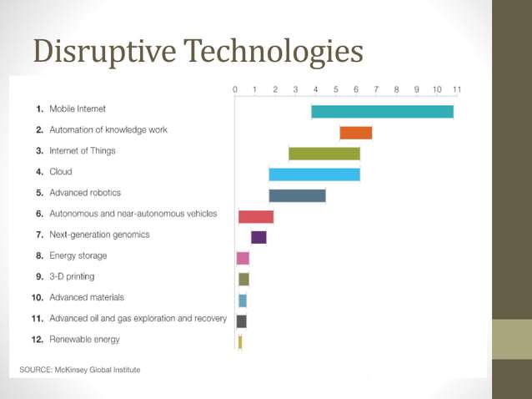

Slide 7
Reading-1
https://blogs.worldbank.org/en/voices/digital-era-all

Slide 8
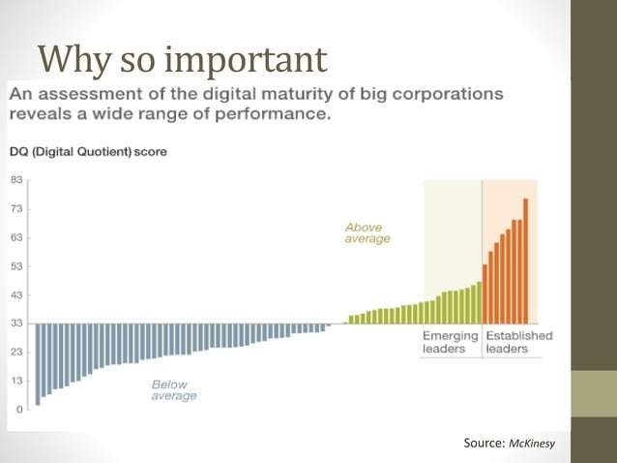

Slide 9
Key Advantages of digitalization to firms
1. Operational Efficiency & Cost Reduction
Automates repetitive tasks (e.g., billing, HR processes, inventory management).
Reduces paperwork, human errors, and time delays.
Cloud-based systems lower IT infrastructure costs.
Example 1: UBL (United Bank Limited) – Introduced digital banking apps and ATMs to reduce branch workload, cut operational costs, and improve transaction speed.
Example 2: Bykea – Uses a mobile app for ride-hailing and parcel delivery, cutting manual booking costs and optimizing routes for efficiency.
Pakistan post.

Slide 10
2. Improved Customer Experience
Provides personalized services using data analytics.
Enables omnichannel communication (social media, apps, websites, chatbots).
Faster service delivery and better responsiveness.
Example 1: Careem Pakistan – Provides real-time ride tracking, flexible payment options, and instant customer support via app.
Example 2: Foodpanda – Offers quick delivery, personalized recommendations, and 24/7 order tracking to enhance user experience.
Example 3: Grab in Malaysia and Thailand

Slide 11
3. Data-Driven Decision Making
Access to real-time data improves forecasting, trend analysis, and strategic planning.
Helps in understanding consumer preferences and behavior.
Predictive analytics supports demand planning and marketing strategies.
Example 1: Daraz.pk – Uses customer browsing and purchase data to recommend products, optimize pricing, and plan sales campaigns.
Example 2: Jazz (Telecom) – Analyzes call/data usage to create customized packages and improve customer retention.

Slide 12
4. Market Expansion
Digital platforms allow entry into global markets.
E-commerce and online services expand customer base without geographical limits.
Firms can adopt new digital business models (subscription etc. e.g., online data bases, Netflix etc.).
Example 1: Sastaticket.pk – Expanded travel booking services online, allowing customers across Pakistan to book flights and hotels easily.
Example 2: Telemart – Grew from a local electronics shop to a national e-commerce platform through digitalization.
Booking.com: Reach to the Hajj and Umrah Market

Slide 13
5. Innovation & Competitive Advantage
Encourages the development of new products, services, and business models.
Helps firms respond quickly to changing market dynamics.
Provides a competitive edge through technology adoption (AI, automation, sensing in the decision making).
Example 1: Easypaisa – Transformed financial services by introducing mobile wallets and QR payments, becoming a leader in fintech.
Example 2: HBL Konnect – Offers branchless banking through mobile apps, giving HBL an edge in reaching unbanked populations.

Slide 14
6. Enhanced Collaboration
Cloud tools (Google Workspace, Microsoft Teams, Slack) improve internal communication.
Remote working enables firms to access global talent.
Digital platforms enhance coordination across supply chains.
Example 1: Systems Limited – Uses cloud collaboration tools for software teams working with international clients.
Example 2: Airlift (before closure) – Managed logistics and delivery teams using digital dashboards and real-time tracking.

Slide 15
7. Brand Visibility & Marketing
Digital marketing increases brand awareness at lower cost compared to traditional methods.
Social media platforms allow direct interaction with customers.
SEO, content marketing, and targeted ads boost sales.
Example 1: Khaadi – Uses social media and e-commerce to expand brand visibility beyond physical stores.
Example 2: Pepsi Pakistan – Runs digital marketing campaigns (e.g., Pepsi Battle of the Bands) to engage younger audiences online.

Slide 16
8. Sustainability & Compliance
Digital workflows reduce paper usage and environmental footprint.
Easier compliance with regulations through digital record-keeping.
Supports ESG (Environmental, Social, Governance) reporting.
Example 1: Meezan Bank – Introduced e-statements to cut paper use, aligning with sustainability goals.
Example 2: TCS Pakistan – Uses digital shipment tracking, improving compliance and reducing paperwork.

Slide 17
9. Financial Growth
Increased revenue through online sales and digital services.
Access to fintech solutions (digital payments, mobile banking, blockchain).
Better cash flow management with automated invoicing and e-payments.
Example 1: Easypaisa & JazzCash – Opened new revenue streams by enabling mobile banking and online payments.
Example 2: Daraz.pk – Earns revenue not only from sales but also from digital ads and sponsored product placements.

Slide 18
Video-2

Slide 19
Consumer Expectations
Speed: Foodpanda fast delivery
Convenience: Easypaisa & JazzCash widely used
Transparency: Daraz refund policy
Trust: Rozee.pk verified reviews

Slide 20
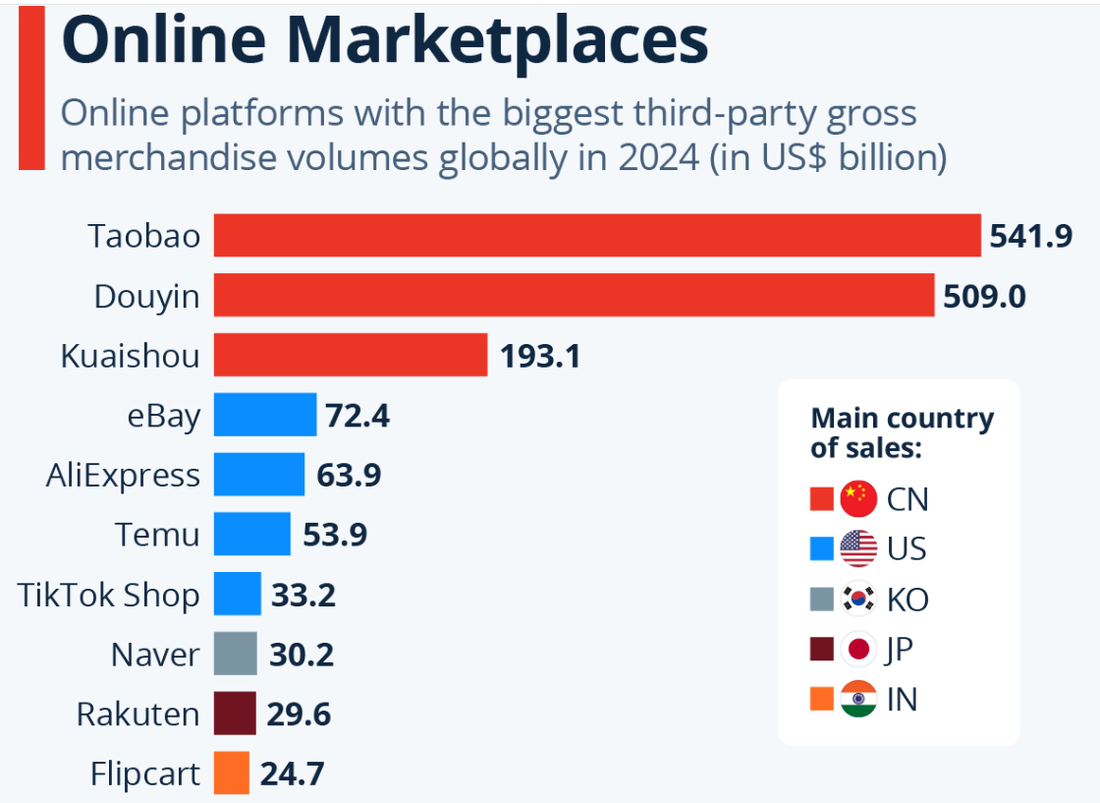
Online Marketplaces

Slide 21
Changing Consumer Behavior
Daraz: Online shopping events like 11.11
Foodpanda: Preference for ordering food online
Careem & Bykea: Ride-hailing apps usage
TikTok & Instagram: Influencing youth purchases

Slide 22
Personalization, Customization & Experience
customization empowers the user to actively change a product or service, while personalization uses data and algorithms to automatically tailor an experience to the user without their direct input.
Daraz App: AI-driven recommendations
Jazz & Telenor: Personalized bundles
UBL & HBL: AI-based chatbots
PakWheels: Personalized car suggestions

Slide 23
Empowered Consumers
Savyour app: Cashback & price comparisons
Shopsy.pk: Real-time reviews
Shift to Value: Infinix & Tecno mobiles replacing costly brands

Slide 24
Key Benefits of Digitalization to Consumers
1. Convenience & Time Saving
Customers can shop, pay bills, or order services anytime, anywhere.
Example 1: Easypaisa – Customers pay utility bills and transfer money instantly without visiting a bank.
Example 2: Foodpanda – Customers save time by ordering meals online instead of going to restaurants.

Slide 25
2. Better Access to Services
Digital platforms make services accessible even in remote areas.
Example 1: JazzCash – Provides mobile banking to people in rural Pakistan where no physical banks exist.
Example 2: OLX Pakistan – Enables customers from small cities to buy/sell products online without needing physical marketplaces.

Slide 26
3. Cost Savings
Online discounts, promotions, and competitive pricing benefit customers.
Example 1: Daraz.pk – Regularly offers mega sales (11.11, Black Friday) with big discounts.
Example 2: Careem – Provides promo codes and ride discounts compared to traditional taxis.

Slide 27
4. Personalization & Choice
Digitalization allows customized recommendations and multiple options.
Example 1: Daraz.pk – Suggests products based on customer browsing and purchase history.
Example 2: Khaadi Online Store – Customers can browse designs, sizes, and colors, and get suggestions tailored to their taste.

Slide 28
5. Transparency & Security
Customers track orders, payments, and services in real-time.
Example 1: TCS Courier – Customers track parcels digitally and know delivery status at every step.
Example 2: HBL Mobile App – Customers securely view transaction history and receive instant alerts for every activity.

Slide 29
6. Enhanced Customer Experience
Quick support, easy refunds, and smooth interactions improve satisfaction.
Example 1: Careem – Offers in-app customer support and instant refunds for failed rides.
Example 2: Airlift Express (before closure) – Gave customers a smooth online grocery shopping experience with fast delivery.

Slide 30
Digitalization in Pakistan (Examples)
E-commerce: Daraz, HumMart, ChaseUp online
Digital Payments: Easypaisa, JazzCash, SadaPay
Healthcare: Sehat Kahani, Oladoc
Entertainment: YouTube, SnackVideo, Netflix
Banking: HBL Konnect, Meezan Internet Banking

Slide 31
Challenges for Consumers
Online Scams: Fake sellers on Facebook
Fraudulent Transactions: Mobile wallet fraud
Digital Divide: Rural areas lack internet
Data Privacy: WhatsApp policy backlash

Slide 32
Conclusion
- Pakistani consumers are more informed & connected
- Businesses must adopt digital-first strategies
- Future: Cashless Pakistan (Raast), AI-driven shopping, AR try-ons

