Slide 1
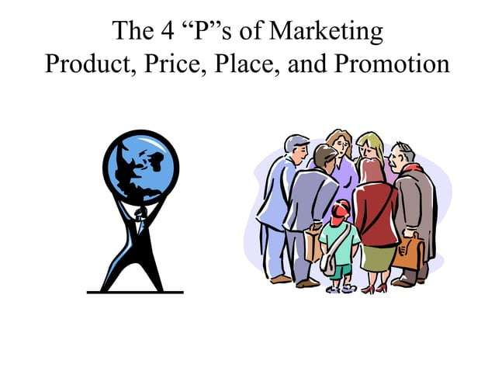

Slide 2
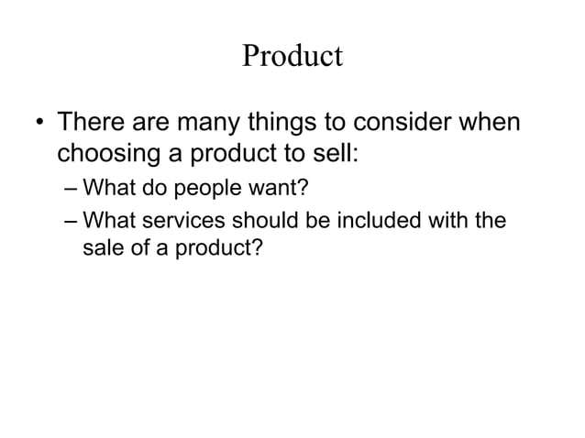

Slide 3
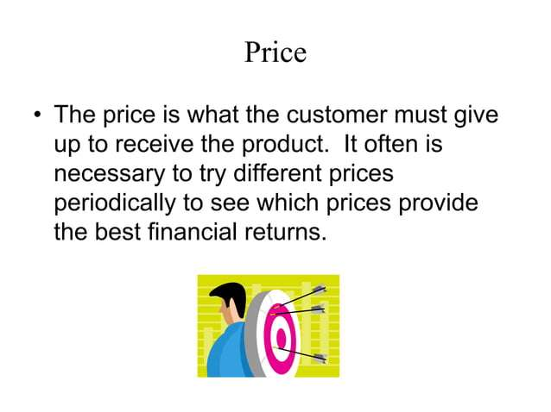

Slide 4
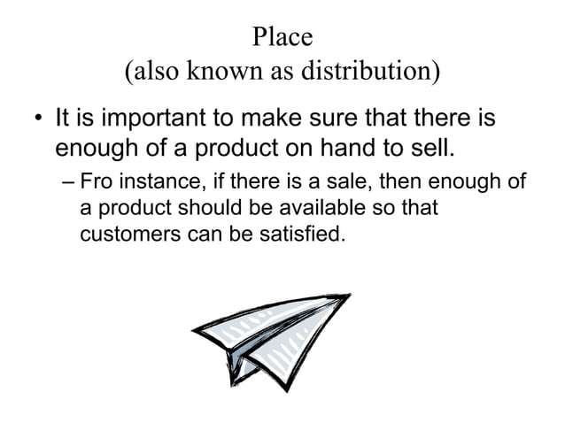

Slide 5
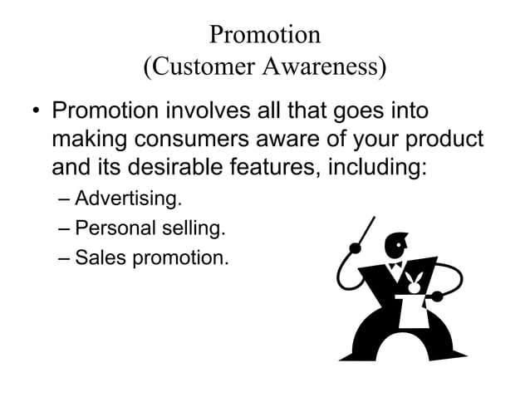

Slide 6
Example 1: Sunsilk (Unilever Pakistan)
Product:
Offers a variety of shampoos targeting different hair types (e.g., Sunsilk Black Shine, Long & Healthy, Anti-Dandruff).
Adapted formula and fragrance to suit Pakistani hair textures and climate.
Price:
Uses value-based pricing, keeping prices affordable for middle-income consumers.
Offers different pack sizes (sachets, small bottles) to attract both rural and urban buyers.
Place:
Widely available across Pakistan — supermarkets, local shops (kiryana stores), and online marketplaces like Daraz.
Promotion:
Uses celebrity endorsements (e.g., Mahira Khan, Alia Bhatt in regional ads).
Runs social media and TV campaigns focusing on “confidence and beauty” for Pakistani women

Slide 7
Example 2: KFC Pakistan
Product:
Offers a mix of international items (Zinger Burger) and local innovations (Zingeratha, Spicy Rice Bowl) to match Pakistani tastes.
Price:
Competitive pricing with meal deals and student offers to attract youth segments.
Occasional discounts via Foodpanda or Careem partnerships.
Place:
Operates outlets in major cities and uses online delivery through KFC app, Foodpanda, and Cheetay.
Promotion:
Digital marketing on Instagram, TikTok, and YouTube.
Youth-focused campaigns such as “Streetwise” meals and “Finger Lickin’ Good” slogan adapted with local humor

