Slide 1
Strategic Planning in Contemporary Marketing

Slide 2
Strategic Planning
Strategic planning defines how organizations identify opportunities, allocate resources, and sustain advantage.
OR
Strategic planning is matching the organizational resources with the marketing opportunities in the loner run
“Strategy without process is little more than a wish list.” – Robert Filek

Slide 3
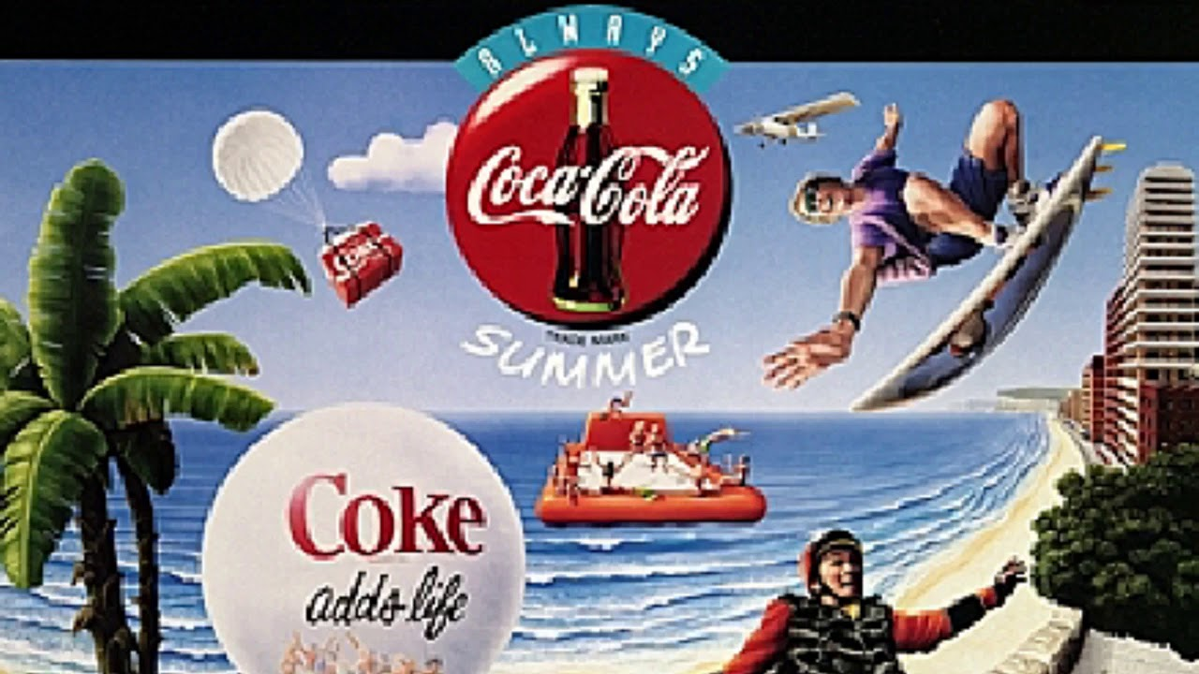
Importance of Strategic Planning
Provides direction and focus
Aligns marketing with organizational goals
Enhances competitiveness
Improves resource allocation
Enables adaptive responses
Example: Coca-Cola’s 'One Brand Strategy' unified its portfolio globally.

Slide 4
Strategic Window
A strategic window is a limited time frame in which a company's competitive strengths align with market needs, creating an optimal opportunity to achieve its goals.
Alignment of strengths and market needs:
It represents a time when a company's internal capabilities are a good fit for the external conditions of the market.
"Golden age":
This period can be seen as a "golden age" where strategic objectives are easier to achieve and profitability increases.
Finite timeframe:
The window is not permanent and can close as competitors respond, technology evolves, or customer needs change.
Strategic importance:
Identifying and acting within this window is crucial for success, as it's the ideal time to execute strategies to gain value or a competitive edge.

Slide 5
Example:
Amazon creating the Kindle Fire HD, a tablet with a reading function, after recognizing the window of opportunity was closing for dedicated e-readers as tablets became more popular.

Slide 6
Management Process in Marketing
Planning
Analyze situation
Set Goals
Select strategies and tactics
Implementation
Organize
Staff
Direct
Evaluation
Comparison of Performance with goals

Slide 7
Strategies
Strategy is a high-level plan or a set of well-aligned activities to achieve a specific, long-term goal within a competitive environment.
Components of a strategy
Goals: The long-term outcome you want to achieve.
Plan: The specific steps and activities that will be undertaken.
Context: The external and internal environment, including challenges, obstacles, and the competitive landscape.

Slide 8
Tactics
It describes the way that the strategy is implemented
Example | Tactics To increase brand awareness, the tactic is to run a social media campaign. | Activities To execute the campaign, activities might include writing posts, creating graphics, and monitoring engagement.

Slide 9
Apple's Strategy and Tactics
Strategy: Become the market leader in consumer smart devices/ electronics/ gadgets.
Tactics:
  Develop innovative products like the iPhone and Apple Watch.
  Use premium marketing to create a brand image of quality and design.
  Build a network of Apple Stores to control the sales experience.

Slide 10
Market Research
The action or activity of gathering information about consumers' needs and wants/preferences.

Slide 11
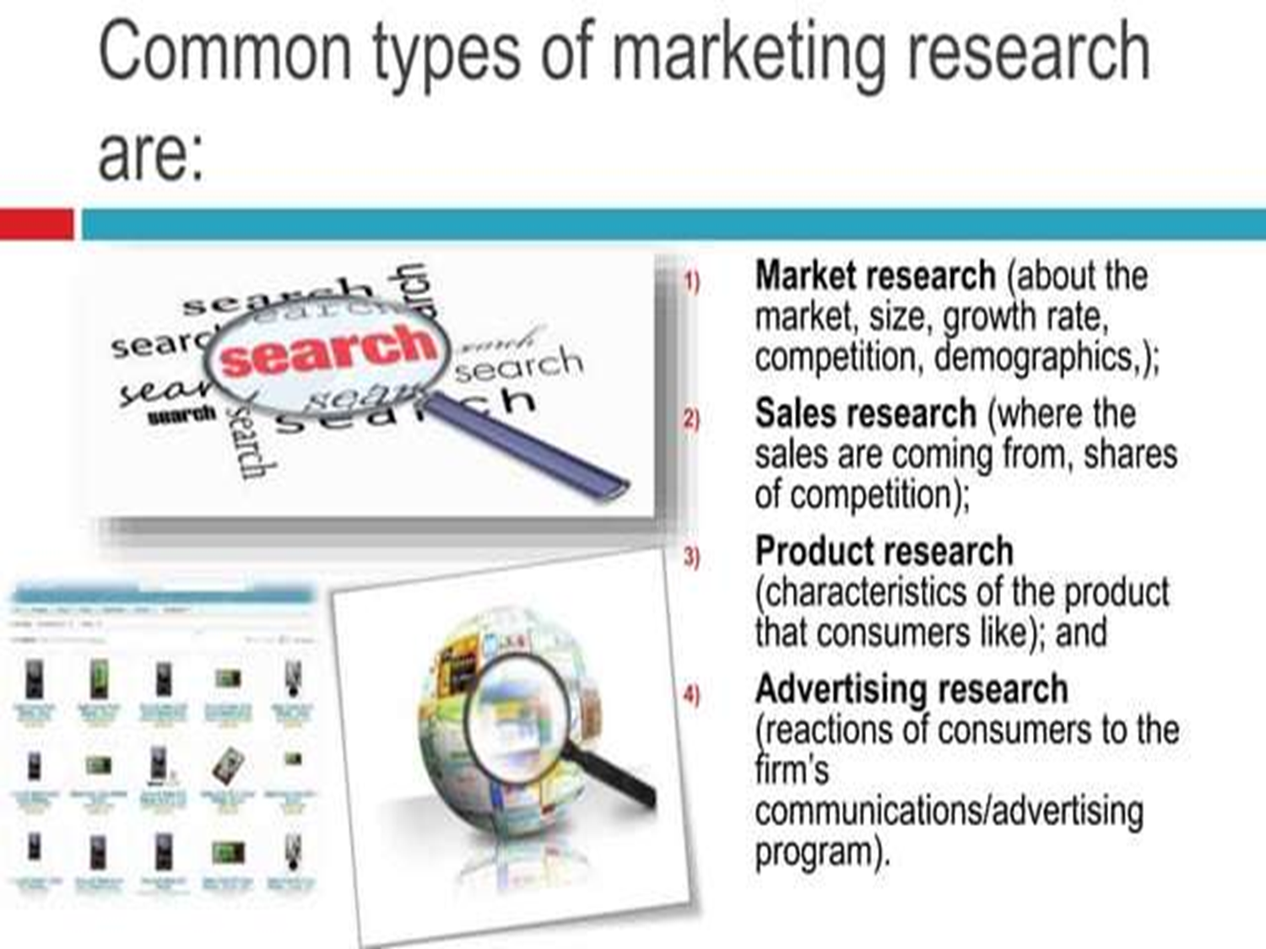

Slide 12
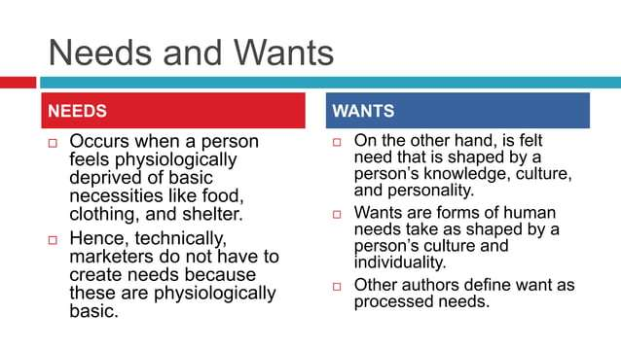

Slide 13
Market Segmentation
Market segmentation is the process of dividing a broad consumer market into smaller groups of consumers who share similar characteristics, needs, and behaviours.
Example:
Clothing brand: Segments the market by age to offer specific styles to different age groups, such as youthful designs for teenagers and more classic styles for older adults.

Slide 14
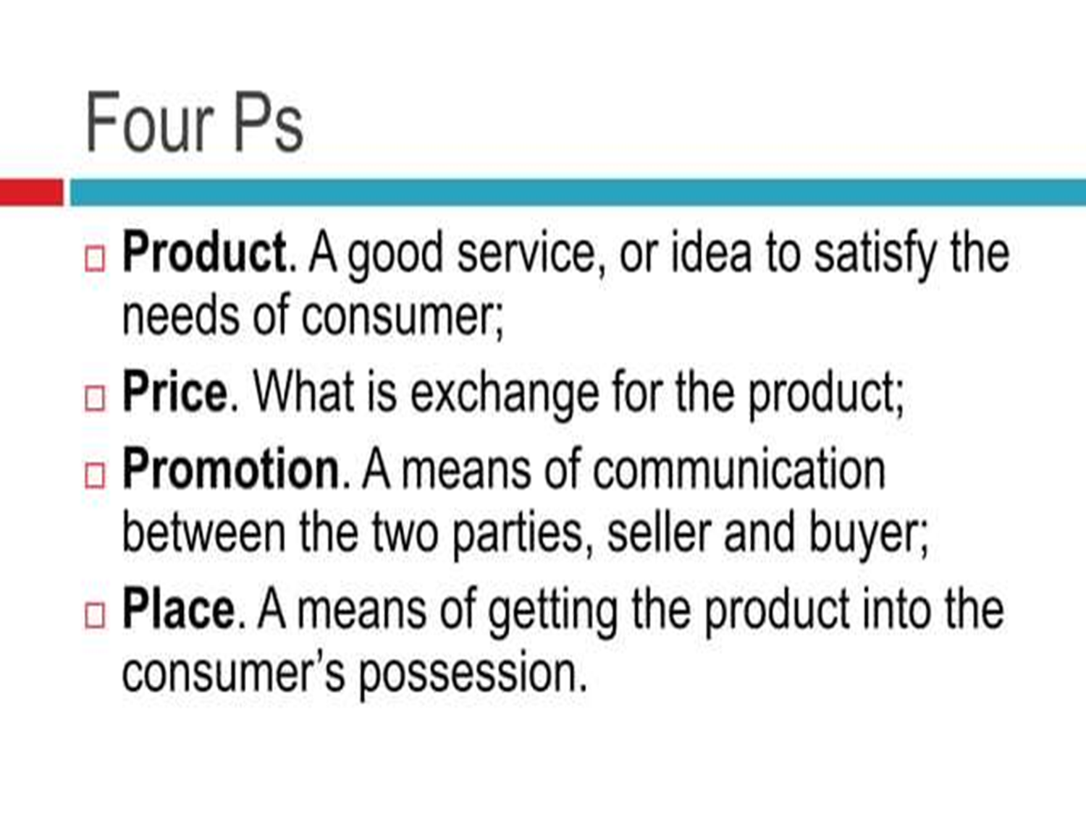

Slide 15
Marketing Mix
The marketing mix is a strategic framework that blends controllable elements to achieve marketing objectives, commonly known as the "4 Ps": product, price, place (distribution), and promotion.
Example: Massive reduction in the prices of SUVs
1. Khaadi: Khaadi focuses on offering high-quality fashion products that blend traditional and modern designs. It follows a value-based pricing strategy, making its clothing affordable yet premium. The brand sells through flagship stores, online platforms, and international outlets. Khaadi promotes its products through social media campaigns, fashion shows, and influencer collaborations, emphasizing individuality and cultural pride.

Slide 16
Pepsi Pakistan:Pepsi provides a variety of beverages such as Pepsi, 7Up, and Sting, appealing to different tastes. It uses competitive pricing to stay attractive compared to Coca-Cola. The products are widely available across urban and rural retail outlets, restaurants, and supermarkets. Pepsi promotes aggressively through celebrity endorsements, sports sponsorships like the Pakistan Super League (PSL), and youth-oriented advertising campaigns.
3. Daraz.pk:Daraz offers a wide range of products through its online platform, ensuring customer convenience and variety. It applies dynamic pricing with frequent sales and discount offers, such as 11.11 and Black Friday events. Being an e-commerce platform, its main place of distribution is its website and mobile app, supported by an efficient delivery network. Daraz promotes its brand through digital marketing, influencer partnerships, and collaborations with banks and telecom companies for special offers.

Slide 17
External Factors & Impact
Other than marketing mix, there are several factors that influence the marketing and its process which are uncontrollable i.e., environmental, social, political, technological etc.
Examples: Fuel consumption efficiency race among the car brands focuses on rapid changes in the technology.

Slide 18
Strategic Marketing Planning Process
1. Situation Analysis (SWOT, PESTEL, 5Cs (Company, Customer, Competitior, Collaborator and climate))
2. Marketing Strategy (STP: Segmentation, targeting and positioning)
3. Marketing Mix (4Ps/7Ps)
4. Implementation
5. Monitoring and Control

Slide 19
Market Opportunity Analysis
1. To evaluate potential business or market opportunities.
2. To determine the attractiveness and probability of success for entering or expanding in a market.
Example: Gourmet entry into Furniture and Pharmacy
Media Tv Channel

Slide 20
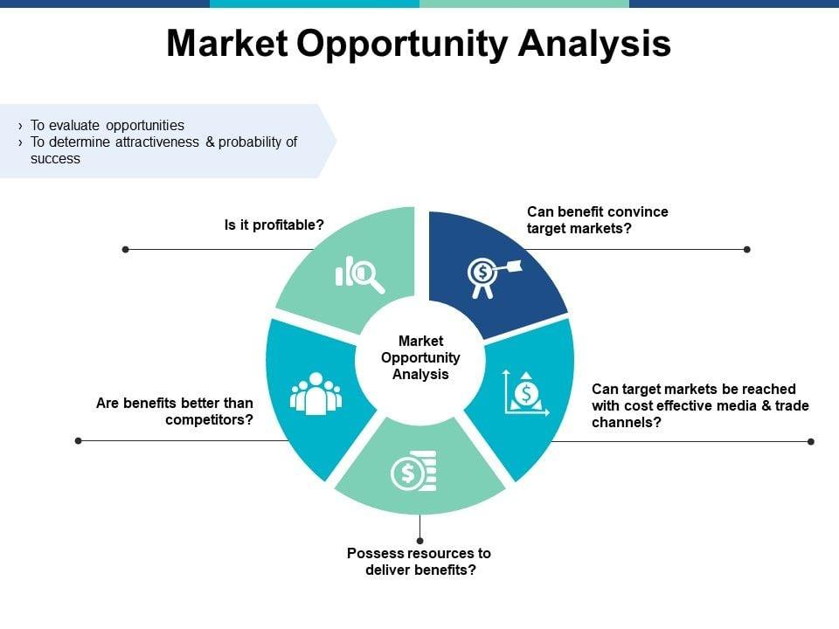

Slide 21
Can benefits convince target markets?
Assess whether your product or service offers a compelling value proposition. Determine if customers clearly understand and trust the benefits you promise.
Can target markets be reached with cost-effective media and trade channels?
Evaluate accessibility to target customers using marketing, distribution, and communication channels. Identify whether these channels are affordable and efficient for your business model.
Possess resources to deliver benefits?
Ensure the organization has financial, human, and operational capabilities to fulfil the market’s expectations. Consider scalability and supply chain readiness.
Are benefits better than competitors’?
Compare your offerings with competitors’ strengths and weaknesses. Identify unique selling proposition (USPs) that make your product more attractive.
Is it profitable? Analyse whether the opportunity will generate sustainable profits after considering costs and risks. Use financial forecasting, ROI analysis, and cost–benefit evaluation.

Slide 22
Connection with Customers
Connection with Customer
Creating customer value and loyalty
Analyzing Consumer Market
Analyzing Business Market
Identifying Market Segmentation and targets

Slide 23
1. Creating Customer Value and Loyalty
The ultimate aim is to deliver superior value to customers so they remain loyal and become brand advocates.
Example: Daraz Pakistan creates customer value by providing fast delivery, return policies, and customer support, ensuring repeat purchases.
Toyota
Honda
Nishat
Saphire
Nestle
Prema
Bundu Khan
Cakes & Bakes

Slide 24
2. Analysing Consumer Market
Marketers study consumer behaviour, preferences, buying patterns, and influences that drive purchasing decisions.
Example:
Khaadi analyses its consumer market to understand trends like eco-friendly fabric preferences and seasonal design choices among young women.
SUVs aggressive selling in Pakistani market. Even the Chinese brands offered the SUVs at first.

Slide 25
3. Analysing Business Market
This focuses on B2B (business-to-business) interactions, understanding other business’s needs and purchase processes.
Example:
Nishat Mills analyses textile buyers (local and international fashion brands) to offer customized fabric solutions according to their requirements.
Denim, Interloop and lot of leather manufacturer look for the other business to buy their products.
Sportswear and surgery equipment manufacturers in Sialkot region target the business to buy.

Slide 26
4. Identifying Market Segmentation and Targets
This step involves dividing the market into distinct groups based on demographics, psychographics, behavior, or geography, and then selecting specific target segments to focus on.
Example: Coca-Cola Pakistan targets different customer segments, Coke Zero for health-conscious youth and Sprite for energetic, adventurous individuals.
Beechtree (Pepperland)
Bata differently target the audience of different provinces
Tesla targeting the environment concerned people
Aramco entrance in Pakistan.

Slide 27
Video-1

