Slide 1
The Nature of Managerial Communication
Lecture 2

Slide 2
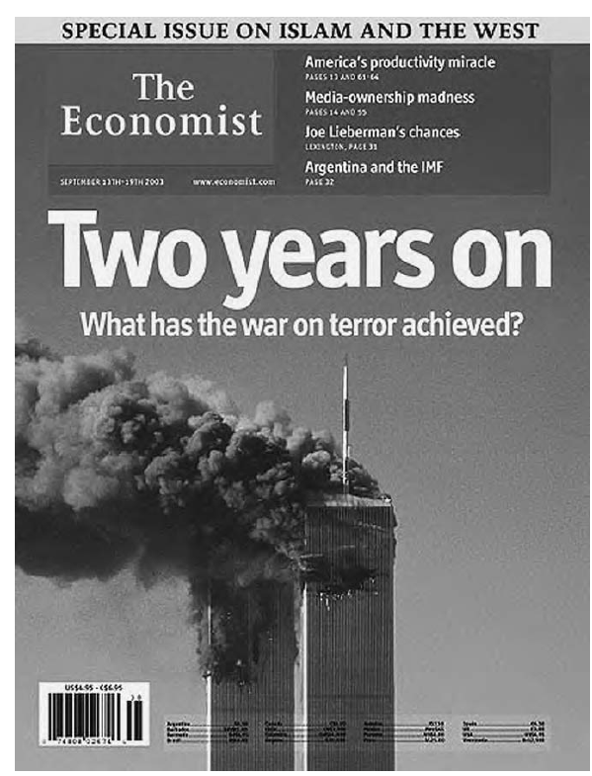
Notes:
Is this effective communication by Boeing in The Economist (September 13, 2003)?

Slide 3
Read this
A recent example of customer dissatisfaction involves British Airways (BA). In September 2023, British Airways experienced widespread criticism when their flight scheduling system encountered major delays and cancellations, leaving many passengers stranded. The airline was accused of poor communication and failure to adequately support affected customers, exacerbating the situation.

Slide 4
Passengers were frustrated by the lack of timely updates and insufficient customer service, which led to an erosion of trust in the brand. This incident highlights how poor communication during service disruptions can significantly damage a company’s reputation and customer satisfaction.

Slide 5
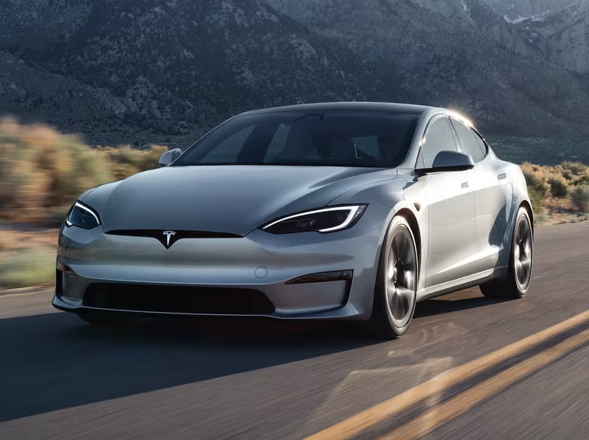
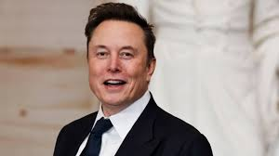
Media Mania
Executives and brand perception.
Notes:
Executives are now public figures, influencing brand perception.
Tesla and Elon Musk Tesla's branding is closely tied to CEO Elon Musk's public persona, which significantly affects customer loyalty and market value.

Slide 6
Activity
Basic: Factories release smoke, which makes the air dirty
Basic: Cars use fuel, which adds bad gases to the air.
Basic: Throwing plastic in the ocean harms sea animals.
Basic: Cutting down forests reduces oxygen in the air.
Basic: Factories dump waste in rivers, making the water dirty
Basic: Using too much water can cause water shortages
Basic: Loud music bothers people and makes them uncomfortable.
Notes:
Improved: Industrial emissions pollute the air, leading to severe environmental and health issues
Improved: Vehicle emissions contribute to air pollution, accelerating climate change
Improved: Marine pollution from plastic waste endangers aquatic life and disrupts ecosystems
Improved: Deforestation depletes oxygen levels by disrupting the natural balance of carbon dioxide and oxygen
Improved: Industrial waste contaminates water bodies, endangering aquatic life and human health
Improved: Excessive water consumption depletes natural reserves, leading to water scarcity
Improved: Noise pollution from excessive sound levels disrupts peace and causes stress

Slide 7
Basic: Factories release smoke, which makes the air dirty
Improved: Industrial emissions pollute the air, leading to severe environmental and health issues
Basic: Cars use fuel, which adds bad gases to the air.
Improved: Vehicle emissions contribute to air pollution, accelerating climate change

Slide 8
Latest problems in corporate communication
Information Overload and Short Attention Spans
Misinformation and Social Media Crises
Declining Employee Trust and Engagement
Cross-Cultural and Digital Communication Gaps
Notes:
Audiences today are bombarded with messages across platforms. With shrinking attention spans, even well-crafted messages get lost.Impact: Employees and customers skim instead of read, leading to misunderstandings.
Social platforms spread both news and rumors instantly. A single post can damage a brand before the company even reacts.
Internal communication often fails to match what leadership says publicly. Remote and hybrid work widened this gap
Global teams use different languages, time zones, and communication norms.

Slide 9
Writing Task
Bad manager: “Just get it done somehow.” | Good Manager:
Bad Manager: “You always mess things up.”
Bad Manager: “I don’t care how you do it — just finish it.”
Bad Manager: “This team never performs well.”
Bad Manager: “This is terrible — do it again.”
Notes:
Good Manager: “Please make sure the report is completed by 4 PM. Let me know if you need any help.”
Good Manager: “Let’s review what went wrong and see how we can avoid it next time.
Good Manager: “I know the deadline is tight, but let’s plan how to complete it efficiently.”
Good Manager: “We’ve faced some challenges, but I’m confident we can improve together.”
Good Manager: “The idea is good, but let’s adjust the format to make it clearer.”

Slide 10
Project
Corporate Branding Strategy for Product Launch in Rural Areas
Objective: Students will develop a corporate branding strategy for launching a product in rural areas, focusing on the unique challenges and opportunities presented by this market.
Activity Overview: Group Formation: Divide the class into small groups of 2-3 students.
Product Selection: Each group will choose or be assigned a specific product to launch in rural areas. Examples could include:

Slide 11
Agricultural tools
Solar-powered appliances
Affordable healthcare products
Eco-friendly packaging
Educational materials or technology

