Slide 1




Language in Organizations and Marketing Campaigns
LECTURE 3

Slide 2
Warm up
Imagine you are pitching a business idea to a potential investor in an elevator ride (around 30 seconds to 1 minute).You can use either a real business idea or come up with a fictional one on the spot.(Think about a slogan)

Slide 3
Read it Yourself
One well-known example is Dolce & Gabbana. In 2018, the luxury fashion brand faced severe backlash after releasing an advertising campaign in China that was considered culturally insensitive and offensive. The campaign featured videos of a Chinese woman struggling to eat Italian food with chopsticks, which many perceived as mocking Chinese culture.
A

Slide 4
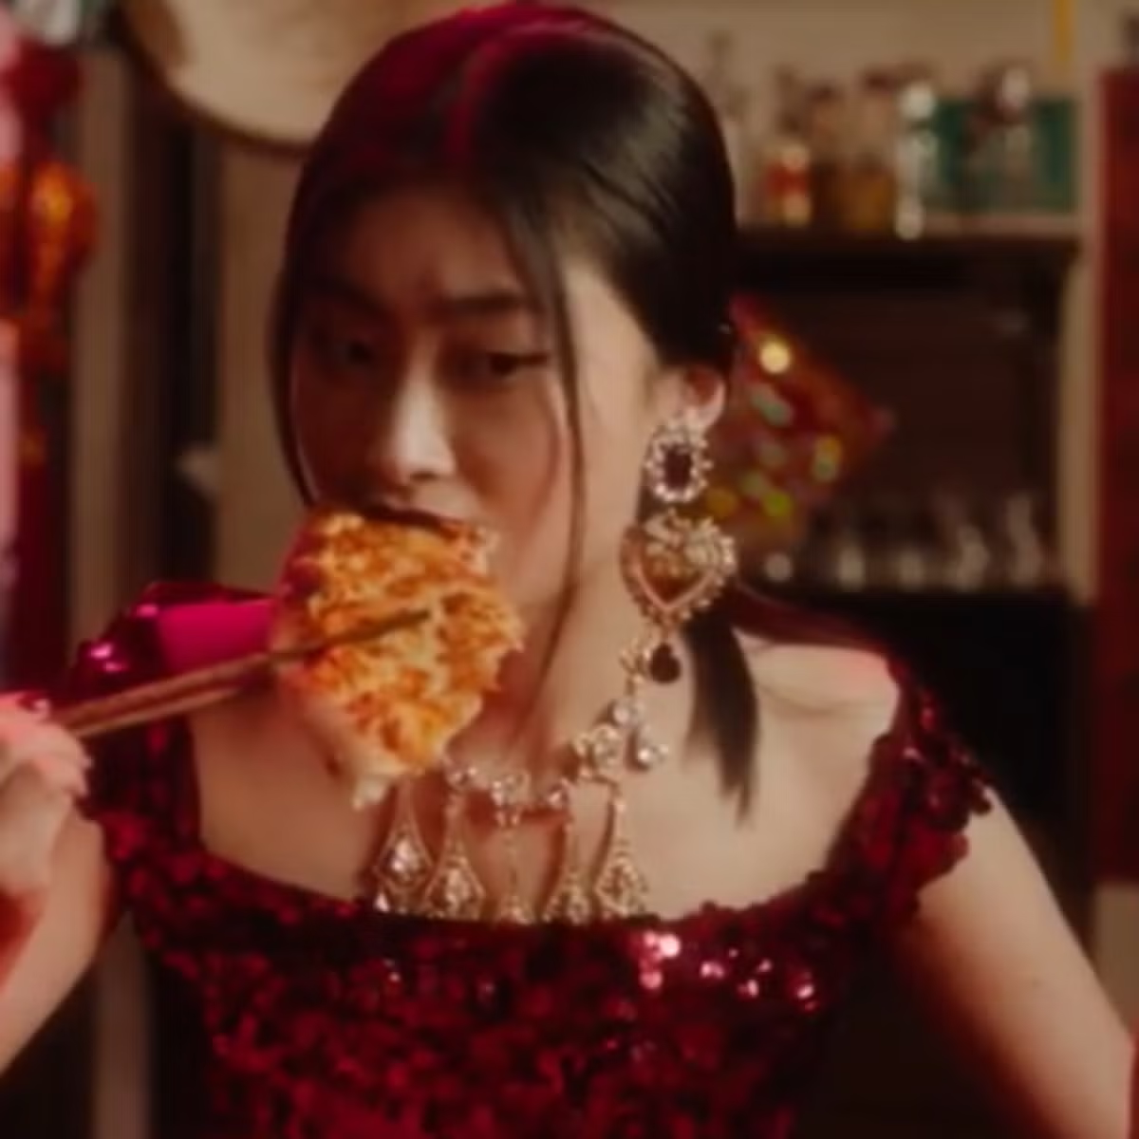

Slide 5
To make matters worse, co-founder Stefano Gabbana allegedly made derogatory remarks about China and Chinese people in private messages that were leaked. This incident caused widespread outrage, leading to the cancellation of a major fashion show in Shanghai, the brand being boycotted by consumers, and numerous retailers pulling their products from shelves. Dolce & Gabbana’s reputation in China was severely damaged, resulting in a long-term negative impact on their brand image and sales in the region.

Slide 6
Language of Hierarchy
1. Do all organizations have same language amongst all departments?
2. Do you think upper management uses authoritative language and lower level employees polite language?
Example: Compare the tone in communication between an entry-level employee addressing a manager and communication between peers within the same team.
Tone: Respectful, formal, and concise.
Example: "Dear Manager, I am writing to request a meeting to discuss my progress on the [project name] project. I would like to share my findings and seek your guidance on the next steps.

Slide 7
Language of Hierarchy
"Peer-to-Peer Communication Within the Same Team:
Tone: Collaborative, informal, and direct.
Example: "Hey team, I wanted to share my thoughts on the [project name] project. I think we should consider [alternative approach]. What do you all think?"

Slide 8
Industry-Specific Jargon
Example:
In the IT industry, terms like “API,” “DevOps,” or “UX” are used frequently, while the financial sector might use terms like “ROI” or “hedging.”
Every industry has its own jargon—specialized language that is understood by insiders but may be unclear to outsiders.
Helps streamline communication but can exclude or confuse those unfamiliar with the industry.

Slide 9
GUESS what industry these terms represent?
Apka apna ghar
Kaam bolo, zyada karo
Best quality, kam daam
Mazay ki baat, sab ka saath
Pakki bhook, tasty food
Maal aur mawafiq
Bharosa aur raftar

Slide 10
Tone and Culture
A language of start up ?
A language of big organizations?

Slide 11
Subject: Exciting News! New Product Launch Coming Soon!
Hi Team,
We're thrilled to announce that our new product, [Product Name], is almost ready for launch! This innovative product has been in development for months, and we're confident that it will revolutionize the [industry] market.
In the coming weeks, we'll be sharing more details about [Product Name], including its features, benefits, and pricing.
We're excited to see how [Product Name] will impact our business and our customers' lives. Thank you for your hard work and dedication to making this launch a success! Best regards,[Your Name][Your Title]
Subject: Important Update: Company-Wide Reorganization
Dear Colleagues,
I am writing to inform you of an upcoming company-wide reorganization that will take effect on [start date]. This reorganization is part of our ongoing efforts to streamline our operations and position the company for continued growth.
We understand that this news may be unsettling, and we want to assure you that we are committed to a smooth transition. We will be providing additional information and support to help you navigate these changes. If you have any questions or concerns, please do not hesitate to reach out to your manager or HR representative. Thank you for your understanding and cooperation.

Slide 12
Poor Language and Communication issues Companies face
IHOP (International House of Pancakes) changed its name to "IHOb" (International House of Burgers). What could be a possible outcome?
Lesson: Overly complex or misleading campaigns can lead to confusion
Notes:
Hennes & Mauritz (H & M)…. Much like how IHOP’s rebranding to IHOb created confusion by shifting its focus from pancakes to burgers, Khaadi's diversification into home products and cosmetics caused some mixed reactions. The expansion into unrelated categories left some customers wondering whether Khaadi was losing its identity as a fashion-focused brand.

Slide 13
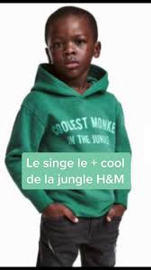
Poor Language and Communication issues Companies face
H&M made an ad black child wearing a hoodie that read, "Coolest Monkey in the Jungle.“
Outcome: ????????????????
Notes:
Hennes & Mauritz (H & M)
a. cultural sensitivities
b. marketing materials

Slide 14
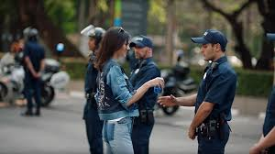
Poor Language and Communication issues Companies face
Issue: Pepsi released a controversial ad featuring Kendall Jenner
Impact: Pepsi faced widespread criticism for being tone-deaf, and the company had to pull the ad and issue an apology.
Notes:
Tone-deaf to real protests – The ad seemed to trivialize the Black Lives Matter (BLM) movement and other serious protests happening worldwide. Oversimplification of activism – It suggested that social justice issues could be solved just by offering a Pepsi.
Pepsi pulled the ad within 24 hours and issued an apology, stating:“Pepsi was trying to project a global message of unity, peace, and understanding. Clearly, we missed the mark, and we apologize.”

Slide 15
Conclusion
Pepsi's protest ad: What language should have been used?
H & M: What type of slogan should have been printed?
Notes:
The language should have clearly acknowledged the complexity and seriousness of social justice movements. Instead of trivializing protests, the ad could have focused on community unity, support for positive causes, and Pepsi as a brand promoting collaboration and dialogue.
A more appropriate approach would be to ensure that the slogan on the clothing is free of any cultural or racial undertones. They could have used more neutral, empowering language, particularly for children's clothing.

Slide 16
Write Improved Version of sentences
Basic: We sell many products.
Basic: The price of this item is too high.
Basic: We need more customers.
Basic: The company is not making enough profit.
Basic: The team works hard.
Basic: We want to grow our business.
Notes:
Improved: Our company offers a diverse range of products to meet customer needs.
Improved: This product is priced at a premium due to its superior quality and features.
Improved: Expanding our customer base is essential for business growth.
Improved: The company’s profit margins need improvement to ensure long-term sustainability.
Improved: Our team demonstrates dedication and efficiency in every project.
Improved: We aim to scale our business by expanding into new markets.

Slide 17
THANK YOU

