Slide 1
Management & Organizational Behavior
Techniques of Recruitment and Selection
Dr. Fazia Kausar

Slide 2
Recruitment Techniques
  Content
    Internal Recruitment: Promotions, transfers, employee referrals.
    External Recruitment: Job portals, social media, campus recruitment, recruitment agencies.
    Modern Trends: AI-based recruitment tools, video interviews, and gamification.

Slide 3
Selection Techniques
  Content:
    Screening: Resume and application review.
    Interviews: Structured, unstructured, behavioral, and situational interviews.
    Assessments: Aptitude tests, personality tests, and skill-based tests.
    Background Checks: Verification of education, employment history, and references.
    Final Decision: Job offer and negotiation.

Slide 4
Linking Job Analysis to Recruitment and Selection
  How Job Analysis Supports Recruitment and Selection
  Content:
    Job analysis provides the foundation for:
      Writing accurate job descriptions and person specifications.
      Identifying key competencies for recruitment.
      Designing effective selection criteria and assessment tools.

Slide 5
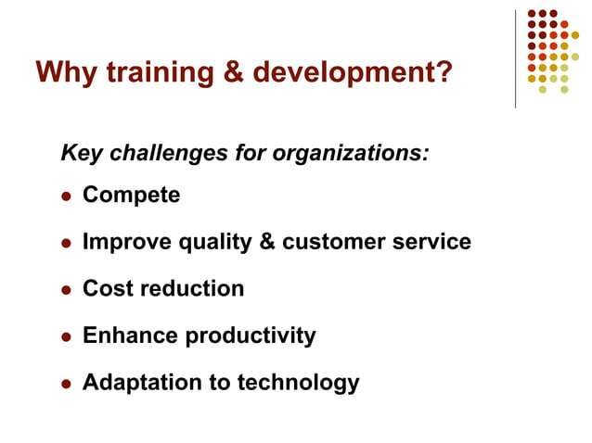


Slide 6
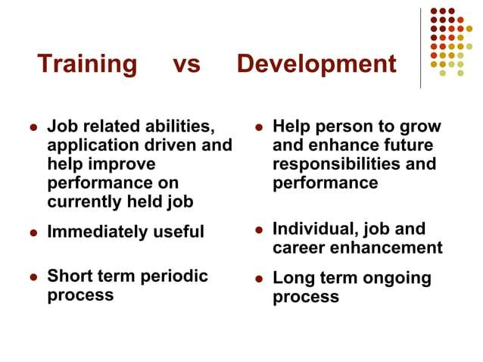

Slide 7
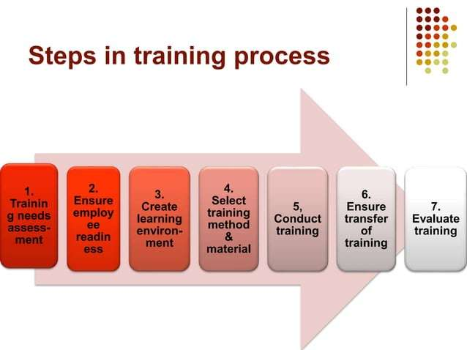

Slide 8
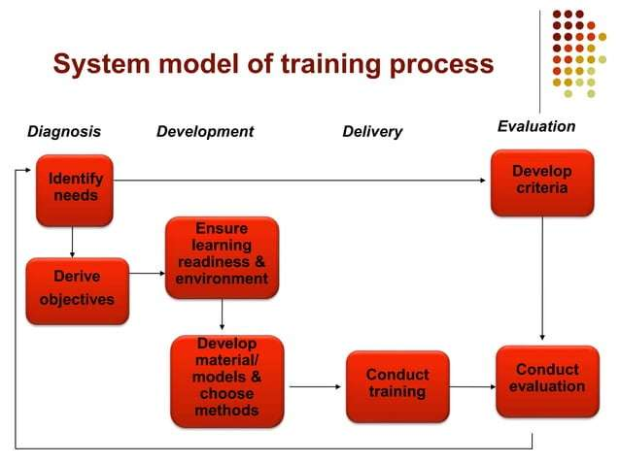

Slide 9
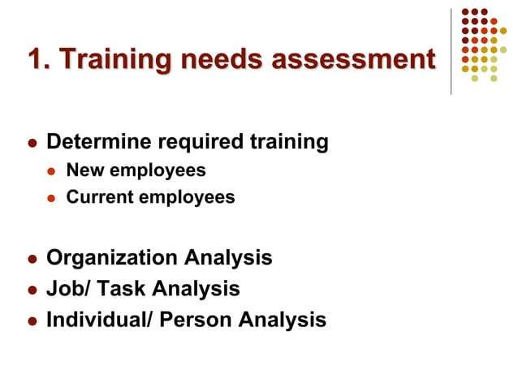

Slide 10
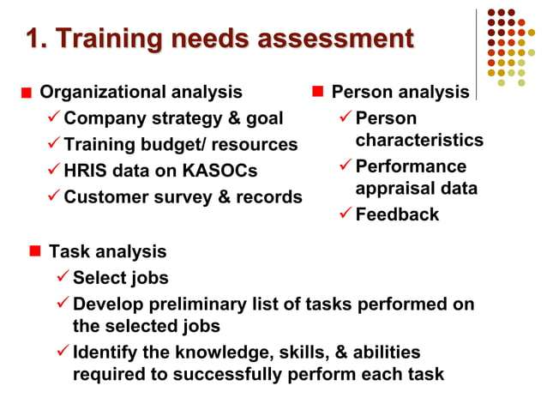

Slide 11
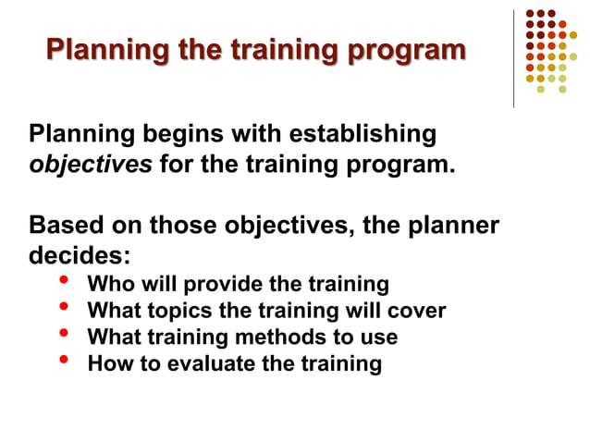

Slide 12
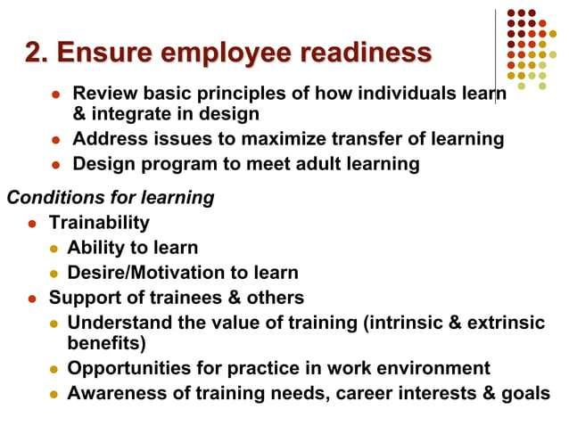

Slide 13
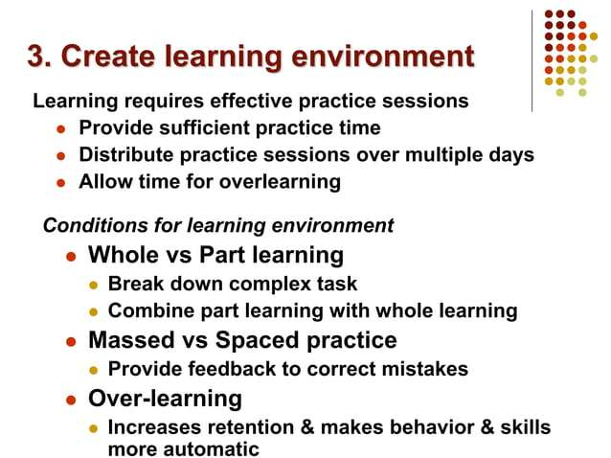

Slide 14
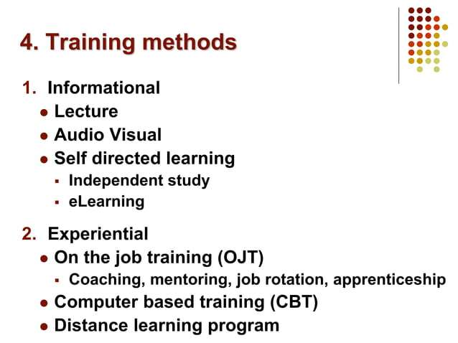

Slide 15
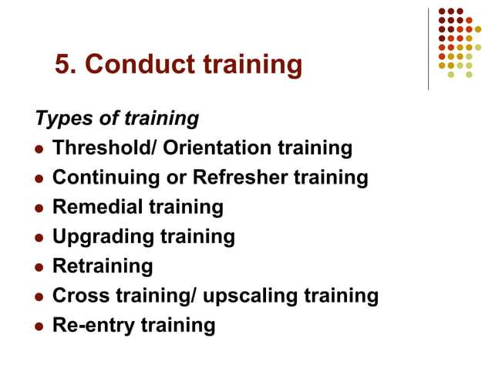

Slide 16
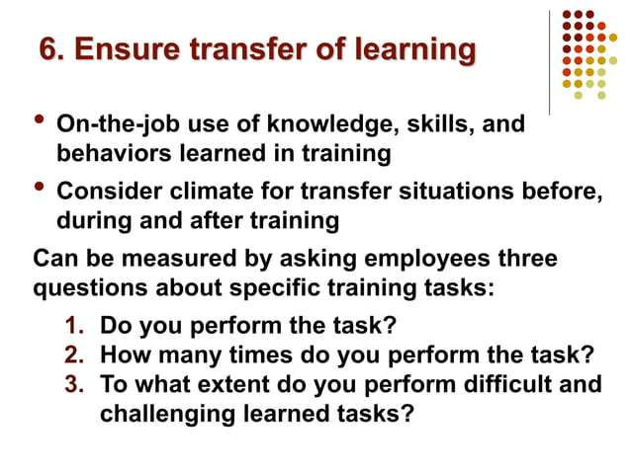

Slide 17
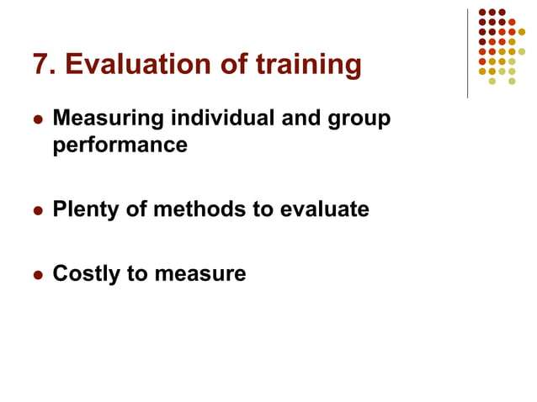

Slide 18
Define personality, describe how it is measured, and explain the factors that determine an individual’s personality
Personality is a dynamic concept describing the growth and development of a person’s whole psychological system;
It looks at some aggregate whole that is greater than the sum of the parts.
Defining Personality
  The text defines personality as the sum total of ways in which an individual reacts to and interacts with others.
Notes:
We begin by defining personality. This is a concept that has a lot of preconceived ideas in people. So we want to ensure we are all using the same basic definition to describe a very complex topic. Personality is a dynamic concept, meaning it is changing all the time, an that is is the total of growth and development of a psychological system for the individual. This suggests it includes all of the components of the psyche and their aggregate becomes greater than any of the parts. So the text definition is that personality if the sum total of ways in which an individual reacts to and interacts with others.

Slide 19
Define personality, describe how it is measured, and explain the factors that determine an individual’s personality
Managers need to know how to measure personality is that personality tests are useful in hiring decisions and help managers forecast who is best for a job.
The most common means of measuring personality is through self-report surveys.
Observer-ratings surveys provide an independent assessment of personality.
Notes:
One of the greatest challenges in the study of personality has been “How we measure it.” The most important reason this is needed is that accurately measuring personality gives managers advantage in the recruitment and hiring processes. It is difficult since most measurement of personality is accrued through self-report surveys filled out by the individuals themselves. However, strides have been made to put personality measurement into observation by others making the determination of personality more independent.

Slide 20
Describe the Myers-Briggs Type Indicator personality framework and assess its strengths and weaknesses
One of the most widely used personality frameworks is the Myers-Briggs Type Indicator (MBTI).
Individuals are classified as:
  Extroverted or introverted (E or I).
  Sensing or intuitive (S or N).
  Thinking or feeling (T or F).
  Perceiving or judging (P or J).
Notes:
One of the most widely used personality frameworks is the Myers-Briggs Type Indicator (MBTI). Individuals are classified as Extroverted or introverted (E or I), Sensing or intuitive (S or N), Thinking or feeling (T or F) Perceiving or judging (P or J). These classifications are then combined into sixteen personality types.

Slide 21
Describe the Myers-Briggs Type Indicator personality framework and assess its strengths and weaknesses
INTJs are visionaries.
ESTJs are organizers.
The ENTP type is a conceptualizer.
Notes:
For example:
INTJs are visionaries. They usually have original minds and great drive for their own ideas and purposes. They are characterized as skeptical, critical, independent, determined, and often stubborn.
ESTJs are organizers. They are realistic, logical, analytical, decisive, and have a natural head for business or mechanics.
The ENTP type is a conceptualizer. He or she is innovative, individualistic, versatile, and attracted to entrepreneurial ideas. This person tends to be resourceful in solving challenging problems but may neglect routine assignments.
MBTI is widely used in practice. Some organizations using it include Apple Computer, AT&T, Citigroup, GE, 3M Co. and others.

Slide 22
Identify the key traits in the
Big Five personality model
Extraversion,
Agreeableness,
Conscientiousness,
Emotional stability,
Openness to experience.
Notes:
An impressive body of research supports that five basic dimensions underlie all other personality dimensions. The five basic dimensions areExtraversion, Agreeableness, Conscientiousness, Emotional stability, Openness to experience. Let’s look at each of these for a minute.
Extraversion is a comfort level with relationships. Extroverts tend to be gregarious, assertive, and sociable. Introverts tend to be reserved, timid, and quiet. Agreeableness is Individual’s propensity to defer to others. High agreeableness people are cooperative, warm, and trusting. Low agreeableness people are cold, disagreeable, and antagonistic. Conscientiousness is a measure of reliability. A high conscientious person is responsible, organized, dependable, and persistent. Those who score low on this dimension are easily distracted, disorganized, and unreliable.Emotional stabilitydescribes a person’s ability to withstand stress. People with positive emotional stability tend to be calm, self-confident, and secure. Those with high negative scores tend to be nervous, anxious, depressed, and insecure. And lastly, Openness to experience suggeststhe range of interests and fascination with novelty. Extremely open people are creative, curious, and artistically sensitive. Those at the other end of the openness category are conventional and find comfort in the familiar.

Slide 23
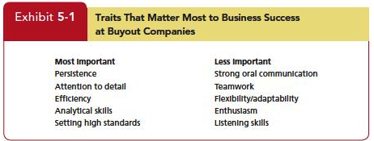
Demonstrate how the Big Five traits predict behavior at work
Notes:
The Big Five Traits predict behavior at work as shown in Exhibit 5-1. Research has shown relationships between these personality dimensions and job performance.Employees who score higher for example in conscientiousness develop higher levels of job knowledge.Conscientiousness is as important for managers as for front-line employee.The study found conscientiousness—in the form of persistence, attention to detail, and setting of high standards—was more important than other traits. These results attest to the importance of conscientiousness to organizational success.Although conscientiousness is the Big Five trait most consistently related to job performance, there are other traits are related to aspects of performance in some situations.

Slide 24
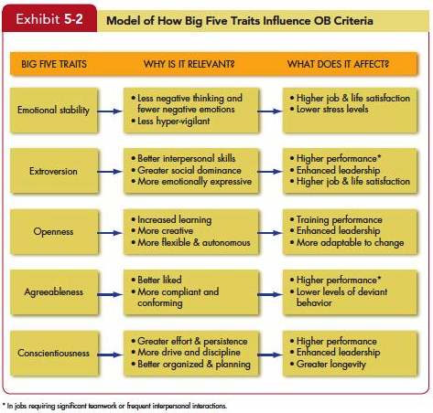
Demonstrate how the Big Five traits predict behavior at work
Notes:
All five traits also have other implications for work and for life. Let’s look at these one at a time. Exhibit 5-2 summarizes the points.
Of the Big Five traits, emotional stability is most strongly related to life satisfaction, job satisfaction, and low stress levels. This is probably true because high scorers are more likely to be positive and optimistic and experience fewer negative emotions. They are happier than those who score low. People low on emotional stability are hypervigilant (looking for problems or impending signs of danger) and are especially vulnerable to the physical and psychological effects of stress.
Extraverts tend to be happier in their jobs and in their lives as a whole. They experience more positive emotions than do introverts, and they more freely express these feelings.They also tend to perform better in jobs that require significant interpersonal interaction, perhaps because they have more social skills—they usually have more friends and spend more time in social situations than introverts. Finally, extraversion is a relatively strong predictor of leadership emergence in groups; extraverts are more socially dominant, “take charge” sorts of people, and they are generally more assertive than introverts. One downside is that extraverts are more impulsive than introverts; they are more likely to be absent from work and engage in risky behavior such as unprotected sex, drinking, and other impulsive or sensation-seeking acts. One study also found extraverts were more likely than introverts to lie during job interviews.
Individuals who score high on openness to experience are more creative in science and art than those who score low. Because creativity is important to leadership, open people are more likely to be effective leaders, and more comfortable with ambiguity and change. They cope better with organizational change and are more adaptable in changing contexts. Recent evidence also suggests, however, that they are especially susceptible to workplace accidents. You might expect agreeable people to be happier than disagreeable people. They are, but only slightly. When people choose romantic partners, friends, or organizational team members, agreeable individuals are usually their first choice. Agreeable individuals are better liked than disagreeable people, which explains why they tend to do better in interpersonally oriented jobs such as customer service. They also are more compliant and rule abiding and less likely to get into accidents as a result.
People who are agreeable are more satisfied in their jobs and contribute to organizational performance by engaging in citizenship behavior. They are also less likely to engage in organizational deviance. One downside is that agreeableness is associated with lower levels of career success (especially earnings).

Slide 25
Demonstrate how the Big Five traits predict behavior at work
The five factors appear in almost all cross-cultural studies.
Studies included a variety of diverse cultures.
Differences are complex but seem to depend on whether countries are predominantly individualistic or collectivistic.
They appear to predict a bit better in individualistic than in collectivist cultures.
https://www.theculturefactor.com/country-comparison-tool
Notes:
The five personality factors identified in the Big Five model appear in almost all cross-cultural studies. These studies have included a wide variety of diverse cultures—such as China, Israel, Germany, Japan, Spain, Nigeria, Norway, Pakistan, and the United States. Differences are complex but tend to be primarily about whether countries are predominantly individualistic or collectivistic. And the Big Five appear to predict a bit better in individualistic rather than in collectivist cultures.

Slide 26
Define values, demonstrate the importance of values, and contrast terminal and instrumental values
  Importance of Values
    Values lay the foundation for the understanding of attitudes and motivation.
    Values generally influence attitudes and behaviors.
    We can predict reaction based on understanding values.
Notes:
Values represent basic convictions in a person.A specific mode of conduct or end-state of existence is personally or socially preferable to an opposite or converse mode of conduct or end-state of existence. Values have both content and intensity attributes. An individual’s set of values ranked in terms of intensity is considered the person’s value system. Values have the tendency to be stable.
The importance of valueslay the foundation for the understanding of attitudes and motivation. Values generally influence attitudes and behaviors. We can predict reaction based on understanding values.

Slide 27
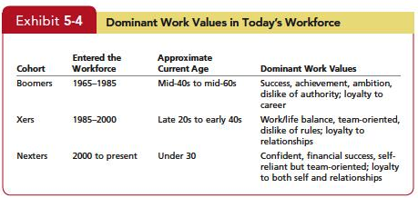
Compare generational differences in values and identify the dominant valuesin today’s workforce
Notes:
First, admit there are some limitations of this analysis of generational differences. One, we make no assumption that the framework applies across all cultures. Two, despite a steady stream of press coverage, there is very little rigorous research on generational values, so we have to rely on an intuitive framework. Finally, these are imprecise categories. There is no law that someone born in 1985 can’t have values similar to those of someone born in 1955. Despite these limitations, values do change over generations, and we can gain some useful insights from analyzing values this way.
Different generations hold different work values. Boomers (Baby Boomers)—entered the workforce during the 1960s through the mid-1980s. Xers—entered the workforce beginning in the mid-1980s. The most recent entrants to the workforce, the Millennials(also called Netters, Nexters, Generation Yers, and Generation Nexters) Though it is fascinating to think about generational values, remember these classifications lack solid research support. Generational classifications may help us understand our own and other generations better, but we must also appreciate their limits.

Slide 28
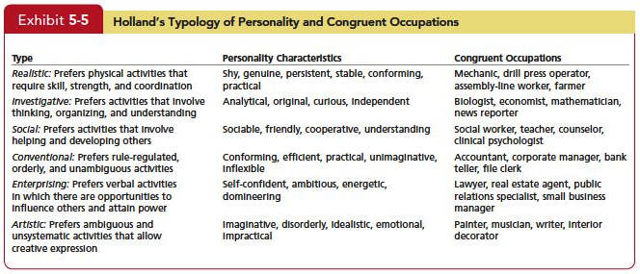
Linking an Individual’s
Personality and Values to the Workplace
Notes:
The concept ofPerson-Job Fitis best articulated in John Holland’s personality-job fit theory. Holland presents six personality types and proposes that satisfaction and the propensity to leave a job depends on the degree to which individuals successfully match their personalities to an occupational environment. He identifies six personality types. They are realistic, investigative, social, conventional, enterprising, and artistic .

Slide 29
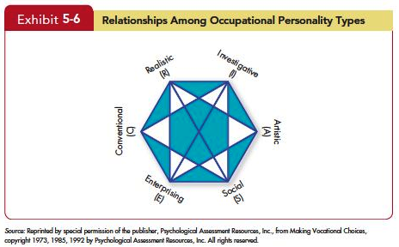
Linking an Individual’s
Personality and Values to the Workplace
Notes:
Each one of the six personality types has a congruent occupational environment. The Vocational Preference Inventory questionnaire contains 160 occupational titles. Respondents indicate which of these occupations they like or dislike. Their answers are used to form personality profiles.The theory argues that satisfaction is highest and turnover lowest when personality and occupation are in agreement. The key points of this model are that there do appear to be intrinsic differences in personality among individuals, there are different types of jobs, and people in jobs congruent with their personality should be more satisfied and less likely to voluntarily resign than people in incongruent jobs.

Slide 30
Linking an Individual’s
Personality and Values to the Workplace
People high on extraversion fit well with aggressive and team-oriented cultures,
People high on agreeableness match up better with a supportive organizational climate than one focused on aggressiveness,
People high on openness to experience fit better in organizations that emphasize innovation rather than standardization.
Notes:
The Person-Organization Fit is most important for an organization facing a dynamic and changing environment. Such organizations require employees who are able to readily change tasks and move fluidly between teams It argues that people leave jobs that are not with their personalities.Using the Big Five terminology, for instance, we could expect that people high on extraversion fit well with aggressive and team-oriented cultures, that people high on agreeableness match up better with a supportive organizational climate than one focused on aggressiveness, and that people high on openness to experience fit better in organizations that emphasize innovation rather than standardization.Research on person–organization fit has also looked at whether people’s values match the organization’s culture. This match predicts job satisfaction, commitment to the organization, and low turnover.

Slide 31
Identify Hofstede’s five value dimensions of national culture
Five value dimensions of national culture:
      Power distance
      Individualism versus collectivism
      Masculinity versus femininity
      Uncertainty avoidance
      Long-term versus short-term orientation
Notes:
Hofstede’s Framework for Assessing Culturessuggests five value dimensions of national culture. First isPower distance,which is the degree to which people in a country accept that power in institutions and organizations is distributed unequally. In Individualism versus collectivism, Individualism is the degree to which people in a country prefer to act as individuals rather than as members of groups. Collectivism equals low individualism. Masculinity versus femininitydescribes Masculinity as the degree to which values such as the acquisition of money and material goods prevail. Femininity is the degree to which people value relationships and show sensitivity and concern for others. Uncertainty avoidanceishe degree to which people in a country prefer structured over unstructured situations. Long-term versus short-term orientationdefine Long-term orientations look to the future and value thrift and persistence. Short-term orientation values the past and present and emphasizes respect for tradition and fulfilling social obligations.

Slide 32
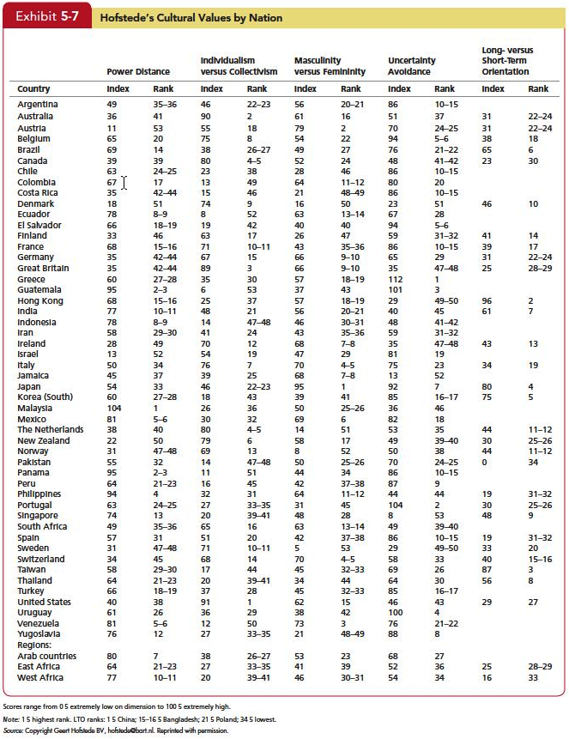
Identify Hofstede’s five value dimensions of national culture
Notes:
Hofstede Research Findings shown in Exhibit 5-7 classify countries on the five dimensions. For example, Asian countries were more collectivist than individualistic.United States ranked highest on individualism. German and Hong Kong rated high on masculinity. Russia and The Netherlands were low on masculinity. China and Hong Kong had a long-term orientation. France and the United States had short-term orientation.
Hofstede’s culture dimensions have been enormously influential on OB researchers and managers, but his research has been criticized. First, although the data have since been updated, the original work is more than 30 years old and was based on a single company (IBM). A lot has happened on the world scene since then. Some of the most obvious changes include the fall of the Soviet Union, the transformation of central and eastern Europe, the end of apartheid in South Africa, and the rise of China as a global power. Second, few researchers have read the details of Hofstede’s methodology closely and are therefore unaware of the many decisions and judgment calls he had to make (for example, reducing the number of cultural values to just five). Some results are unexpected. Japan, which is often considered a highly collectivist nation, is considered only average on collectivism under Hofstede’s dimensions. Despite these concerns, Hofstede has been one of the most widely cited social scientists ever, and his framework has left a lasting mark on OB.

Slide 33
Identify Hofstede’s five value dimensions of national culture
The Global Leadership and Organizational Behavior Effectiveness (GLOBE) began updating Hofstede’s research with data from 825 organizations and 62 countries.
Variables similar to Hofstede
  Assertiveness
  Future orientation (similar to Long-term vs Short-term orientation)
  Gender differentiation (similar to Masculinity vs Femininity)
Notes:
The Global Leadership and Organizational Behavior Effectiveness (GLOBE) began updating Hofstede’s research with data from 825 organizations and 62 countries. It uses variables similar to Hofstede includingAssertiveness,Future orientation (similar to Long-term vs Short-term orientation),Gender differentiation (similar to Masculinity vs Femininity). There are more.

Slide 34
Identify Hofstede’s five value dimensions of national culture
Uncertainly avoidance
Power distance
Individualism/collectivism
In-group collectivism
Performance orientation
Humane orientation
Notes:
Additional variables included in GLOBE are Uncertainly avoidance,Power distance,Individualism/collectivism,In-group collectivism, Performance orientation (the degree to which a society encourages and rewards group members for performance improvement and excellence), and Humane orientation (whichis the degree to which a society encourages and rewards group members for performance improvement and excellence).

Slide 35
Summary and Implications for Managers
Big Five provides a meaningful way for managers to examine personality
Managers’ keys
      Screening job candidates for high conscientiousness
      Factors such as job demands, the degree of required interaction with others, and the organization’s culture are examples of situational variables that moderate the personality–job performance relationship.
Notes:
Under the category of Personality, we looked at the Big Five Traits.The Big Five provides a meaningful way for managers to examine personalityManagers’ key for the application of the Big Five include Screening job candidates for high conscientiousness,as well as the other Big Five traits depending on the criteria an organization finds most important,should pay dividends. Of course, managers still need to take situational factors into consideration.Factors such as job demands, the degree of required interaction with others, and the organization’s culture are examples of situational variables that moderate the personality–job performance relationship.

Slide 36
Summary and Implications for Managers
You need to evaluate the job, the work group, and the organization to determine the optimal personality fit.
Other traits, such as core self-evaluation or narcissism, may be relevant in certain situations, too.
Although the MBTI has been widely criticized, it may have a place in organizations.
Notes:
You need to evaluate the job, the work group, and the organization to determine the optimal personality fit. Other traits, such as core self-evaluation or narcissism, may be relevant in certain situations, too.Although the MBTI has been widely criticized, it may have a place in organizations. In training and development, it can help employees better understand themselves, help team members better understand each other, and open up communication in work groups and possibly reduce conflicts.

Slide 37
Summary and Implications for Managers
Knowledge of an individual’s value system can provide insight into what makes the person “tick.”
Employees’ performance and satisfaction are likely to be higher if their values fit well with the organization.
The person who places great importance on imagination, independence, and freedom is likely to be poorly matched with an organization that seeks conformity from its employees.
Notes:
Our discussion of Values found that knowledge of an individual’s value system can provide insight into what makes the person “tick.”Employees’ performance and satisfaction are likely to be higher if their values fit well with the organization. The person who places great importance on imagination, independence, and freedom is likely to be poorly matched with an organization that seeks conformity from its employees.

Slide 38
Summary and Implications for Managers
Managers are more likely to appreciate, evaluate positively, and allocate rewards to employees who fit in, and employees are more likely to be satisfied if they perceive they do fit in.
This argues for management to seek job candidates who have not only the ability, experience, and motivation to perform but also a value system compatible with the organization’s.
Notes:
Managers are more likely to appreciate, evaluate positively, and allocate rewards to employees who fit in, and employees are more likely to be satisfied if they perceive they do fit in. This argues for management to seek job candidates who have not only the ability, experience, and motivation to perform but also a value system compatible with the organization’s.

Slide 39
Identify Hofstede’s five value dimensions of national culture
https://www.theculturefactor.com/country-comparison-tool

