Slide 1
Managerial economics
Lecture 2
Chapter 3: Demand and supply

Slide 2
basis for demand
Demand: quantity of a good or service that customers are willing and able to purchase during a specified period under a given set of economic conditions.
Law of Demand: There is a negative relationship between price and quantity demanded
Market Demand: Aggregate of individual demand. This is useful for managerial decision-making.
Direct Demand: Demand for goods and services that directly satisfy consumer desires.
Utility: value or worth of a good or service. It is the prime determinant of direct demand.
Derived Demand: Demand for inputs used in production.

Slide 3
Shifts in demand curve
Income
  Normal Goods: Increase in income will increase demand
  Inferior Goods: Increase in income will decrease demand (cup of noodles, public transport)
Prices of Related Goods
  Complements: increase in price of one good decreases the demand of the other good (bread and butter, milk and tea, cars and petrol)
  Substitutes: increase in price of one good increases the demand of the other good (butter and margarine, Pepsi and Coke, Xbox and PlayStation)
  Tastes
    Seasons
    Trends/Fashion
    Advertising
  Expectations
    Expecting an increase in income in next month would mean you would save less today and spend more on buying goods and services
    If prices are expected to rise in future, then consumers would buy more goods at present
    Number of Buyers
  A higher number of buyers would increase the demand of the good

Slide 4
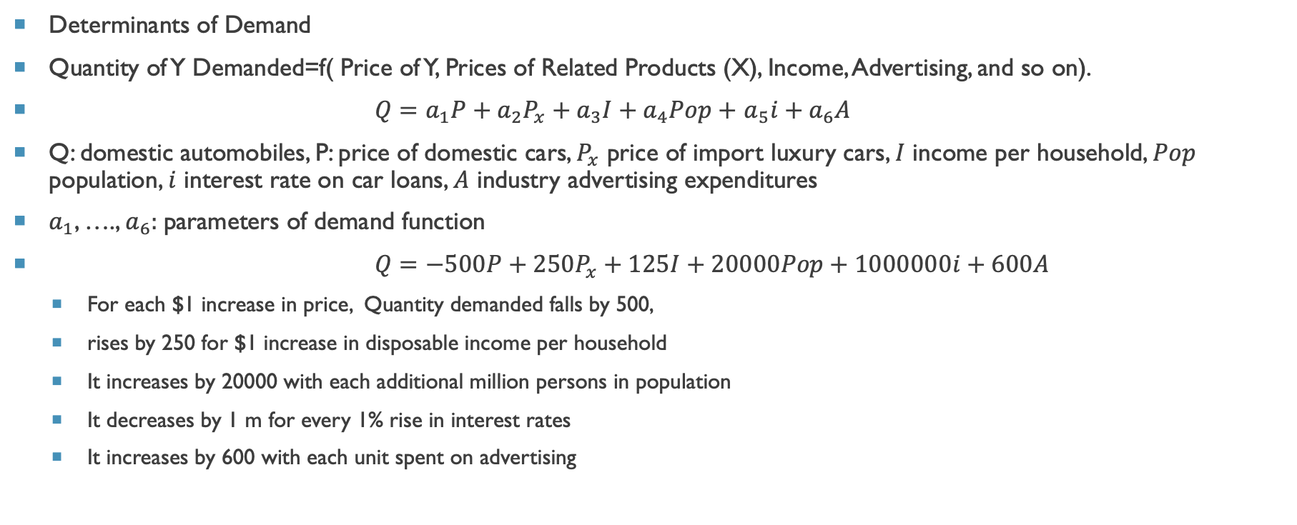
Market demand function
Determinants of Demand
Quantity of Y Demanded=f( Price of Y, Prices of Related Products (X), Income, Advertising, and so on).
$Q=a_{1}P+a_{2}P_{x}+a_{3}I+a_{4}Pop+$ $a_{5}i+a_{6}A$
Q: domestic automobiles, P: price of domestic cars, $P_{x}$ price of import luxury cars, $I$ income per household, $Pop$ population, $i$ interest rate on car loans, $A$ industry advertising expenditures
$a_{1}$, …., $a_{6}:$parameters of demand function
$Q=−500P+250P_{x}+125I+20000Pop+1000000i+600A$
  For each $1 increase in price, Quantity demanded falls by 500,
  rises by 250 for $1 increase in disposable income per household
  It increases by 20000 with each additional million persons in population
  It decreases by 1 m for every 1% rise in interest rates
  It increases by 600 with each unit spent on advertising

Slide 5
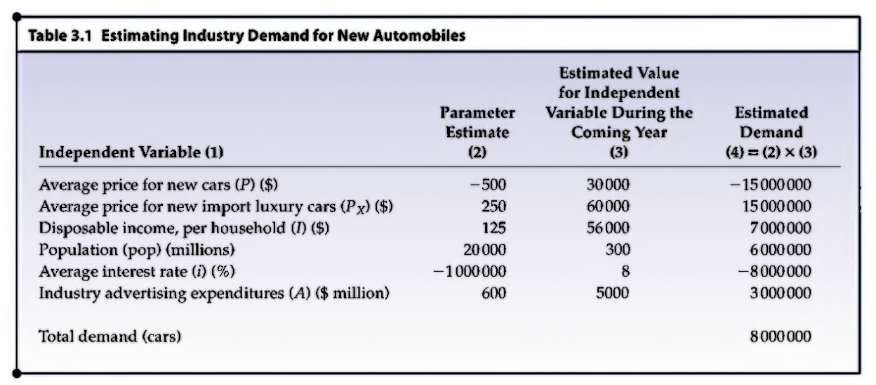
demand
$Q=−500P+250P_{x}+125I+20000Pop+1000000i+600A$

Slide 6
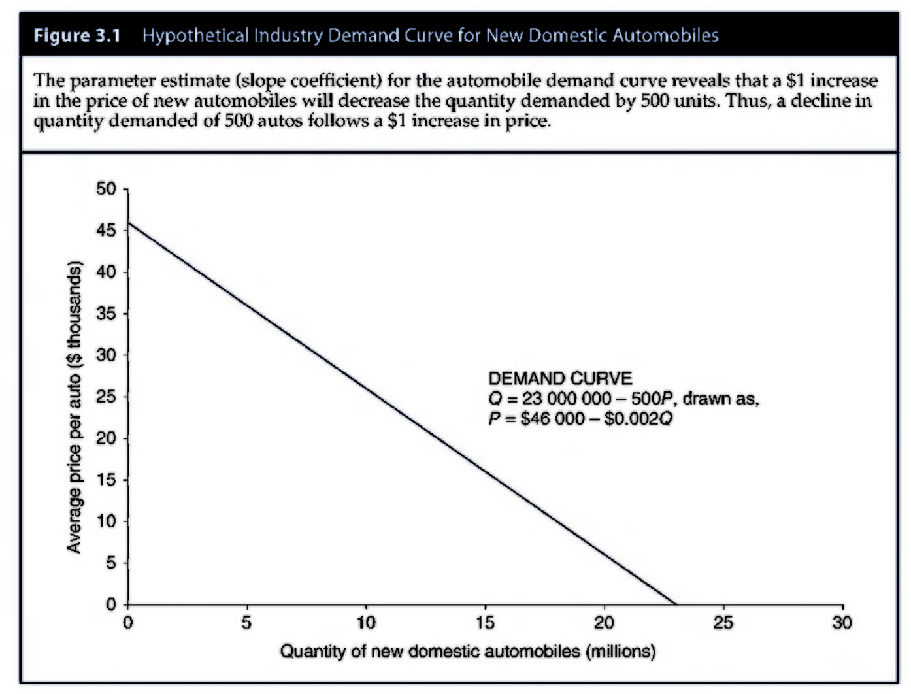
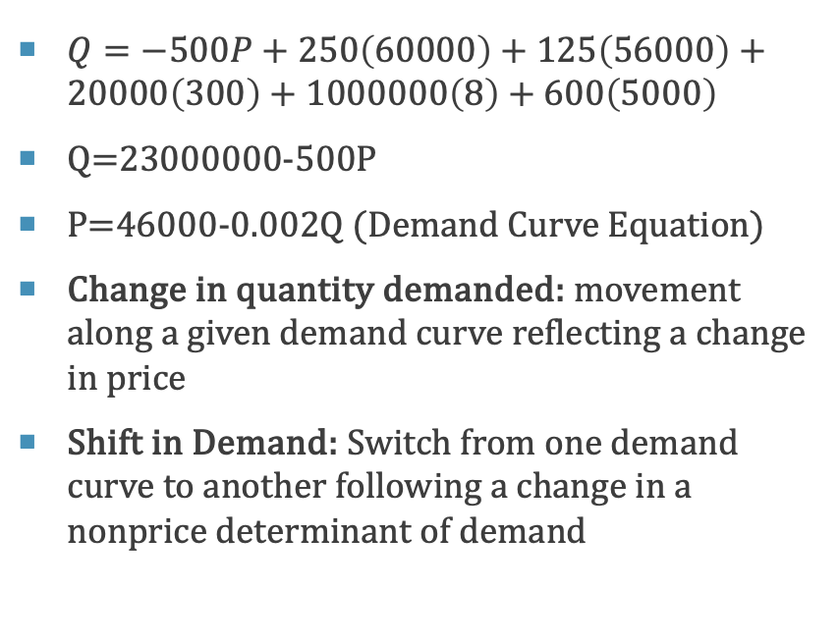
Demand curve
$Q=−500P+250\left(60000\right)+125\left(56000\right)+20000\left(300\right)+1000000\left(8\right)+600\left(5000\right)$
Q=23000000-500P
P=46000-0.002Q (Demand Curve Equation)
Change in quantity demanded: movement along a given demand curve reflecting a change in price
Shift in Demand: Switch from one demand curve to another following a change in a nonprice determinant of demand

Slide 7
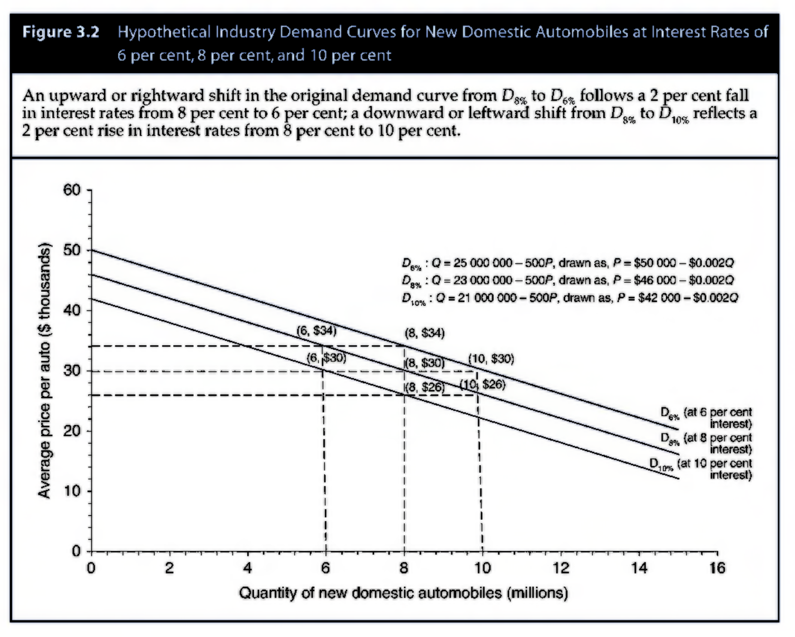
Shift in demand
D6% is another demand curve apart from D8%
A decrease in interest rates increases the demand for cars.

Slide 8
Basis for supply
How Output prices affect supply
Market Supply: aggregate amount supplied by individual firms
Supply arises from ability to enhance firm’s value maximization objective
The amount of any good supplied will rise when Marginal Benefit (MB)>Marginal Cost (MC) of production.
It will fall when Marginal Benefit (MB)<Marginal Cost (MC) of production.

Slide 9
Shifts in supply
Price of Inputs
  Input: anything used to produce a good or service e.g. raw materials, electricity, labor
  An increase in price of input makes producing a good more expensive and less profitable decreasing supply (and vice versa)
  For example if the price of apples decreases, juice companies will be willing to supply more apple juice for each price
  Prices of substitutes in production
  Substitutes in production are alternative goods a firm could switch to producing
  If the price of a substitute in production changes, it becomes relatively more or less attractive to produce a good
  For example beef and lamb are substitutes in production for a farmer. If the price of beef increases, farmers will switch from lamb to beef. This reduces the supply of lamb.
  Technological Change
    Technology: manner in which inputs are transformed into outputs
  Developments in technology allow firms to produce more output from the same set of inputs
  For example, automation allowed the auto industry to produce more cars with fewer workers
  Weather
  Temperature, rainfall and wind can increase or decrease supply
  Heavy rainfall can delay or prevent the planting of crops decreasing supply

Slide 10
question
Use a supply and demand diagram to illustrate the eﬀect of the following:
  An unexpected temporary heat wave hits Karachi. Show the eﬀect on the ice cream market in Karachi.
  The government introduces a tax on ice cream which is paid by producers. What is the eﬀect in the ice cream market?
  A sharp rise in fuel prices on the ride-hailing (Uber/Careem) market.
  A fall in the price of microchips used in smartphone production.
  A subsidy to dairy farmers reducing the cost of milk for ice cream producers

Slide 11
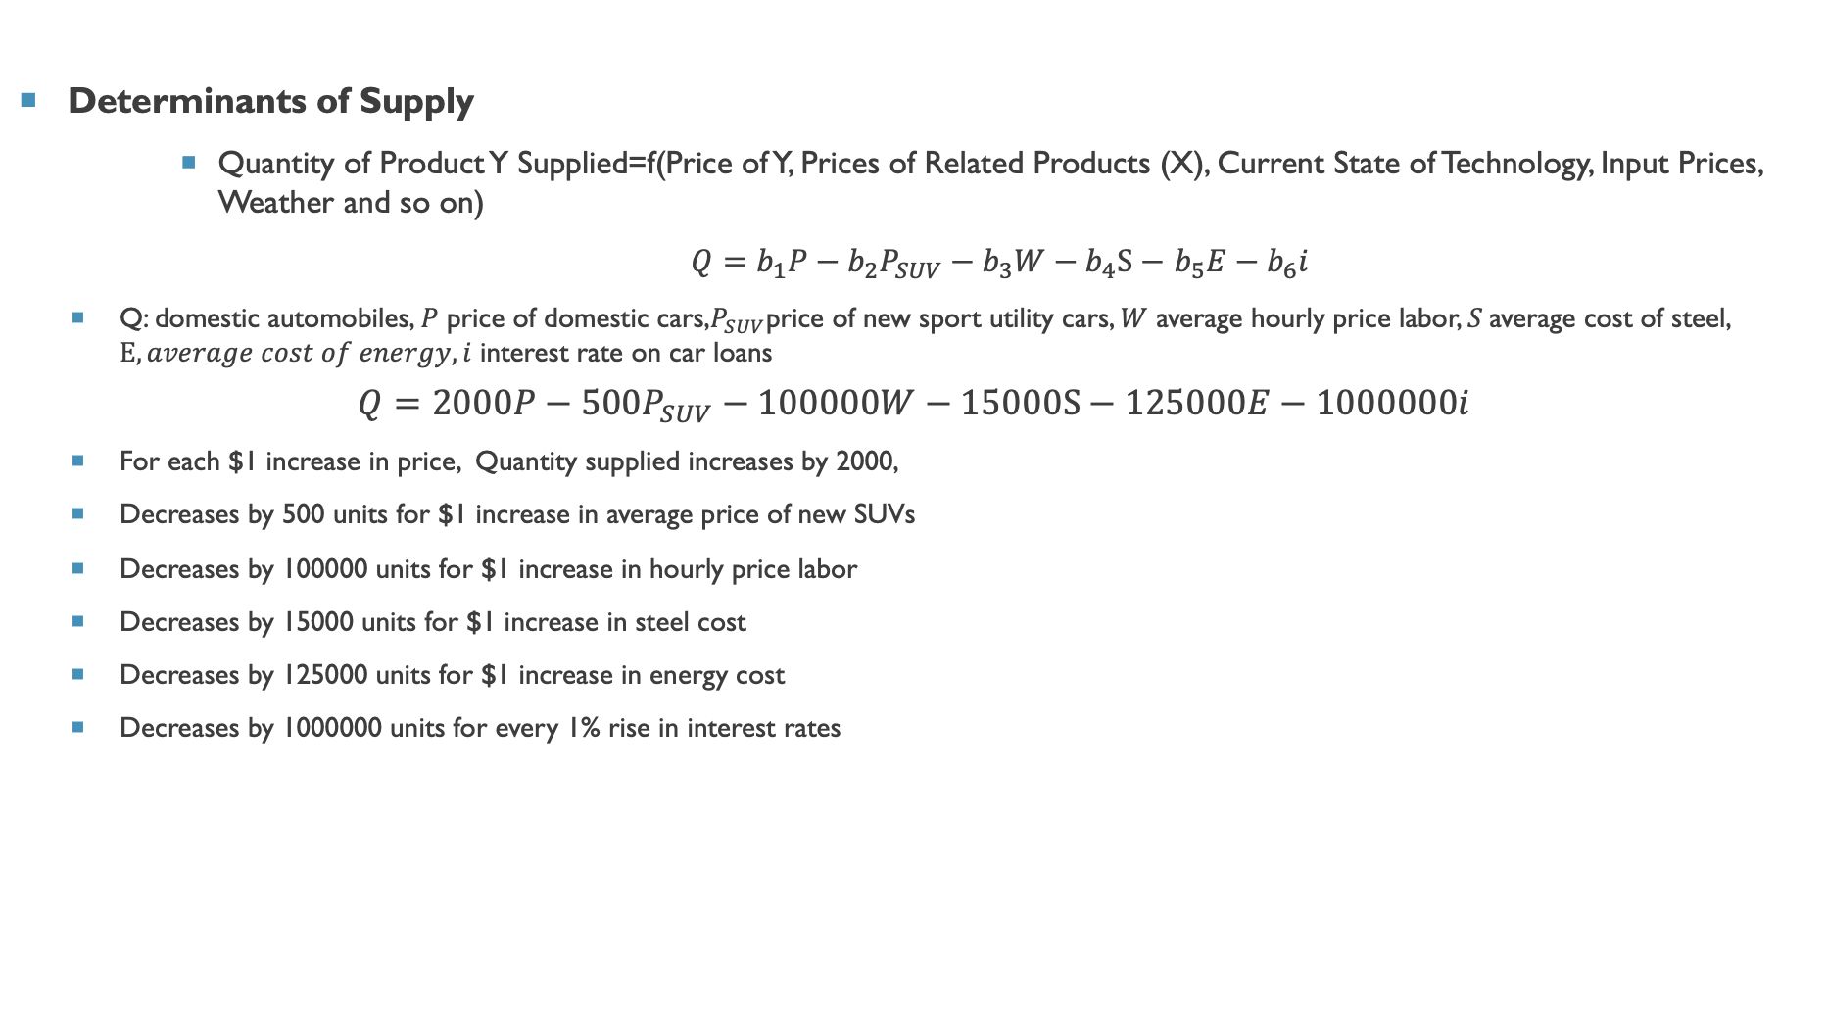
Market supply function
Determinants of Supply
      Quantity of Product Y Supplied=f(Price of Y, Prices of Related Products (X), Current State of Technology, Input Prices, Weather and so on)
      $Q=b_{1}P−b_{2}P_{SUV}−b_{3}W−b_{4}S−$ $b_{5}E−b_{6}i$
  Q: domestic automobiles, $P$ price of domestic cars,$P_{SUV}$price of new sport utility cars, $W$ average hourly price labor, $S$average cost of steel, $E, average cost of energy, i$ interest rate on car loans
$$Q=2000P−500P_{SUV}−100000W−15000S−125000E−1000000i$$
  For each $1 increase in price, Quantity supplied increases by 2000,
  Decreases by 500 units for $1 increase in average price of new SUVs
  Decreases by 100000 units for $1 increase in hourly price labor
  Decreases by 15000 units for $1 increase in steel cost
  Decreases by 125000 units for $1 increase in energy cost
  Decreases by 1000000 units for every 1% rise in interest rates

Slide 12
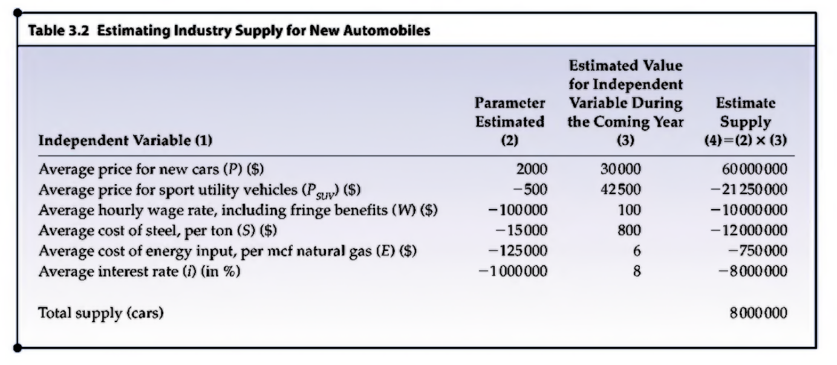
Industry supply

Slide 13
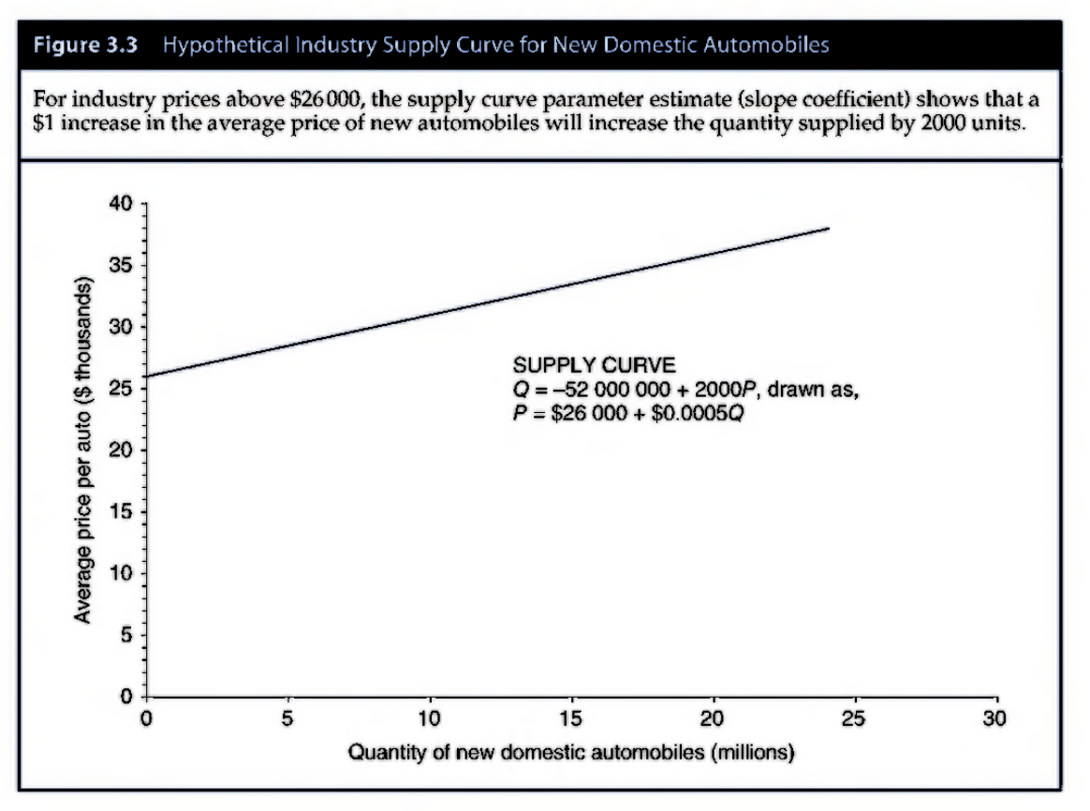
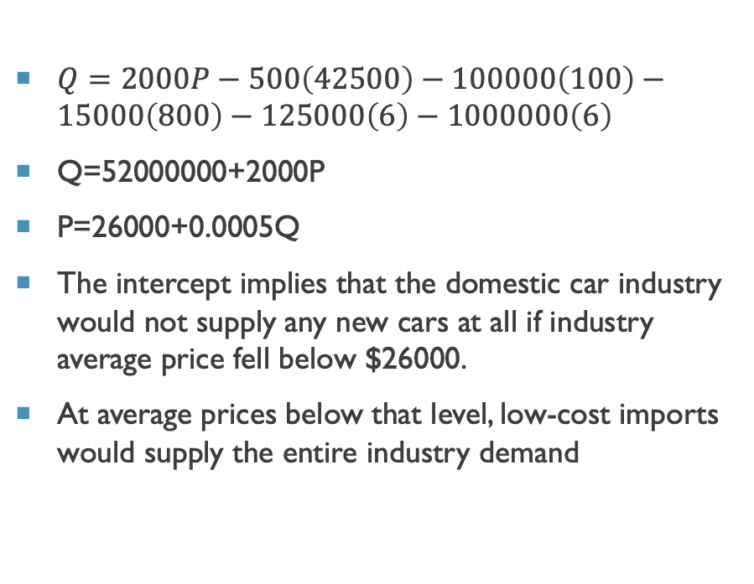
Supply curve
$Q=2000P−500\left(42500\right)−100000\left(100\right)−15000\left(800\right)−125000\left(6\right)−1000000\left(6\right)$
Q=52000000+2000P
P=26000+0.0005Q
The intercept implies that the domestic car industry would not supply any new cars at all if industry average price fell below $26000.
At average prices below that level, low-cost imports would supply the entire industry demand

Slide 14
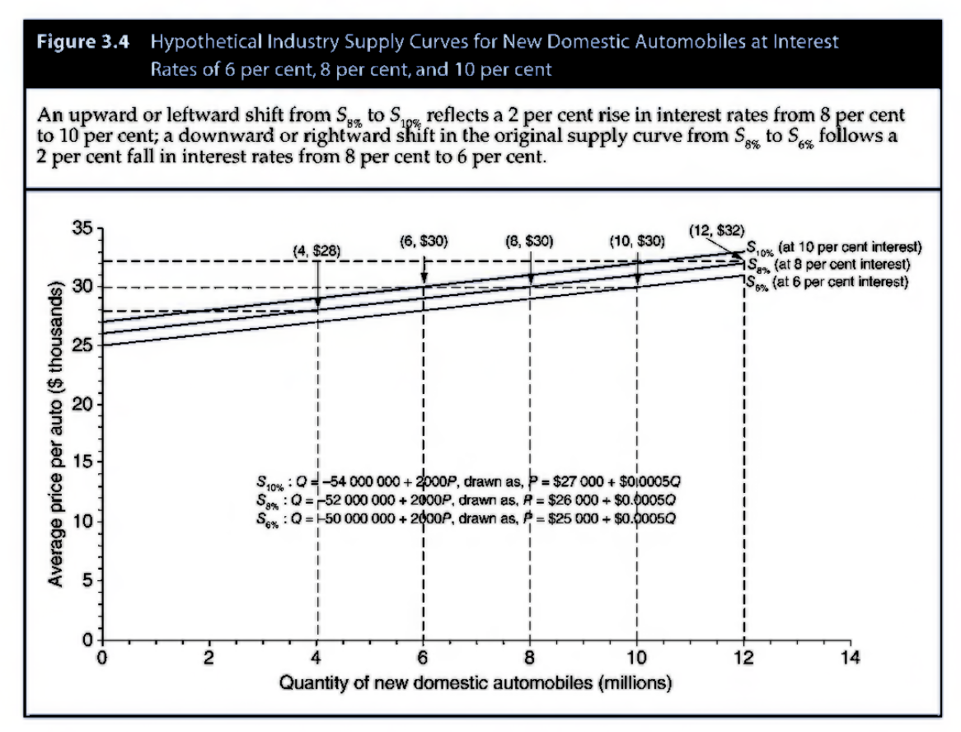
Supply curve
Change in quantity supplied: movement along a supply curve reflecting a change in price
Shift in Supply: movement from one supply curve to another following a change in a nonprice determinant of supply

Slide 15
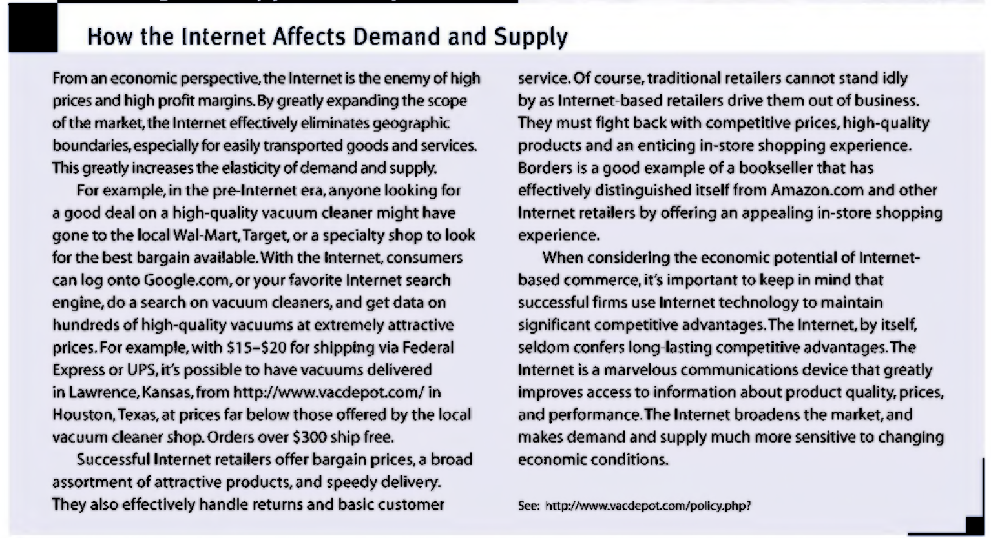
Case study 1: how internet affects demand and supply

Slide 16
Case study 1: how internet affects demand and supply
Internet helps to eliminate geographic boundaries and also offers bargain prices, a higher diversity of attractive products and speedy delivery.
It also handles effectively handle returns and basic customer service.
Traditional retailers: fight back with competitive prices, high quality products and a good in-shopping experience.
Internet also helps to access information about product quality, prices and performance.
It helps broaden the market, and makes demand and supply more sensitive to changing economic conditions.

Slide 17
Market equilibrium
Equilibrium: Perfect balance in demand and supply
Surplus: Excess supply: producers supply more of a product at a given price than buyers demand
Shortage: Excess demand: buyers demand more of a product at a given price than producers are willing to supply.
Neither shortage nor surplus will occur when a market is in equilibrium
Shortage or surplus represent market disequilibrium.
Market forces will bring the market back into equilibrium

Slide 18
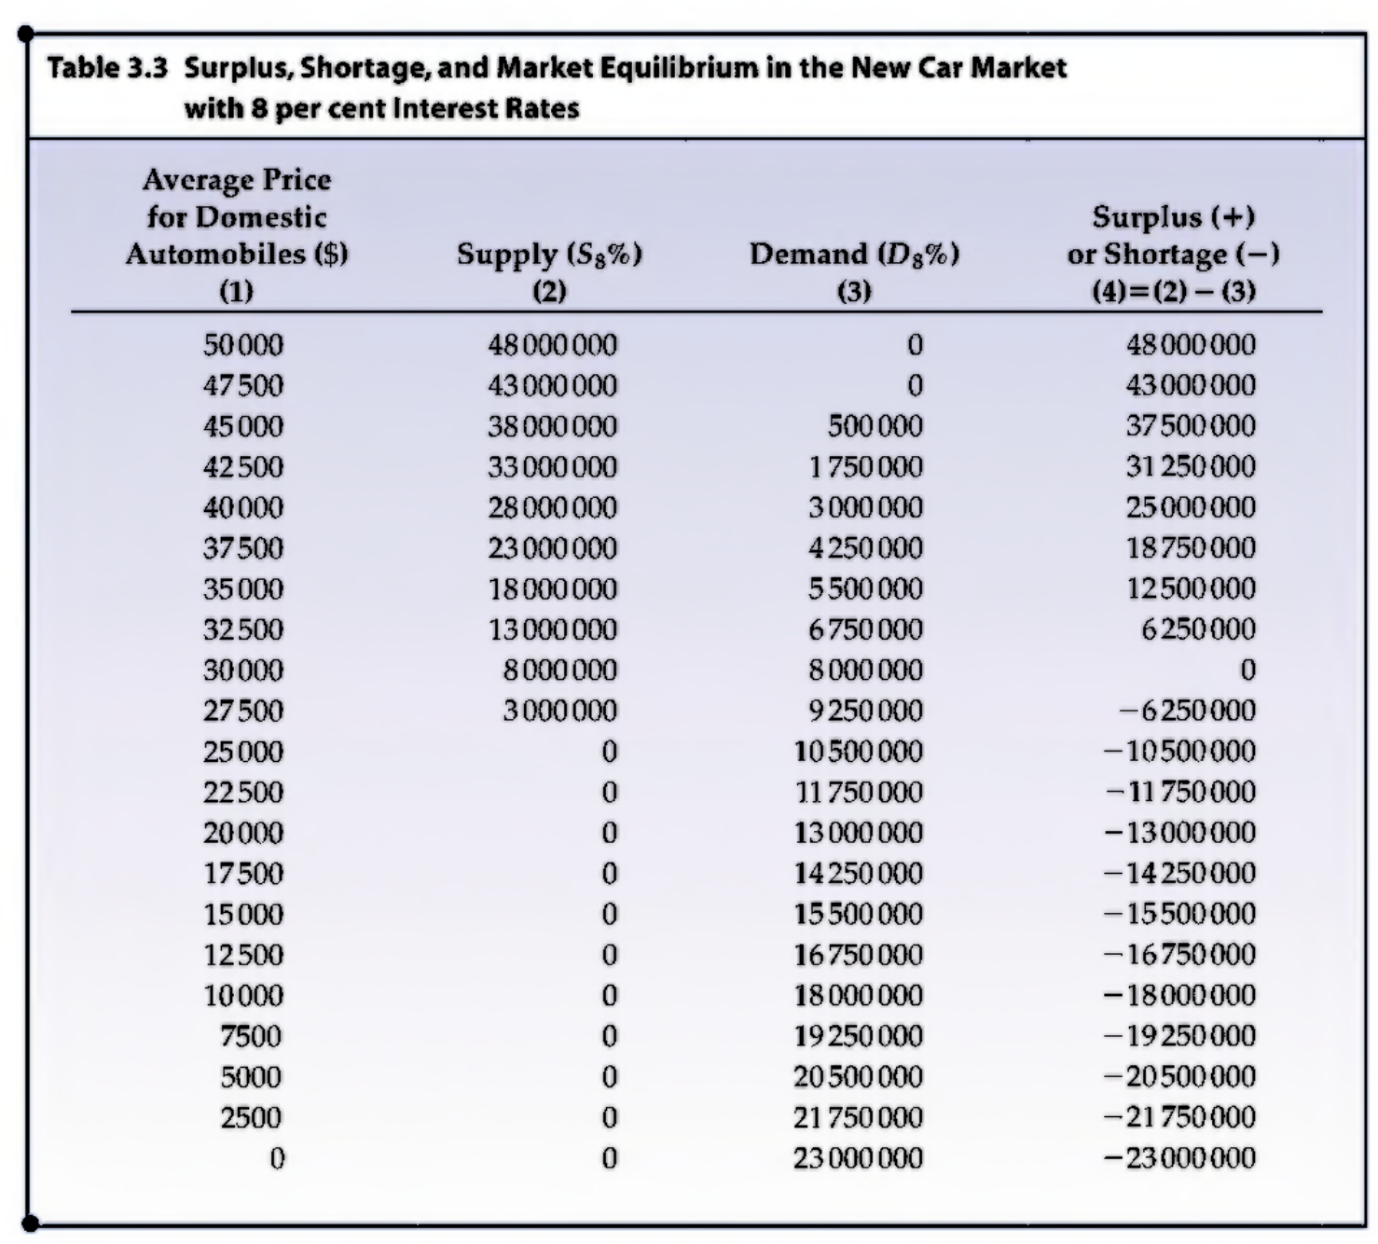
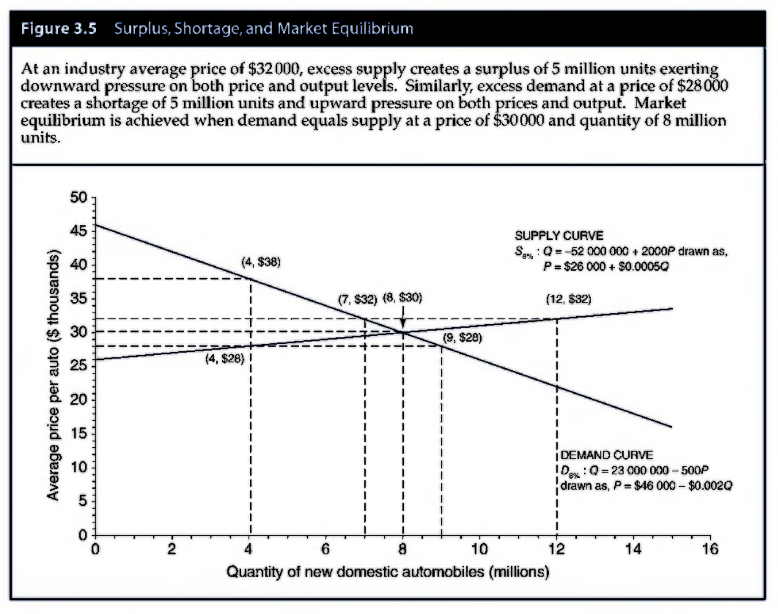
Surplus, shortage & market equilibrium

Slide 19

Equilibrium price
$To determine equilibrium price$
$Q_{D}$=25000000-500P
$Q_{s}$=52000000+200P
$Q_{D}$=$Q_{S}$
Find P, quantity demanded and quantity supplied.

Slide 20
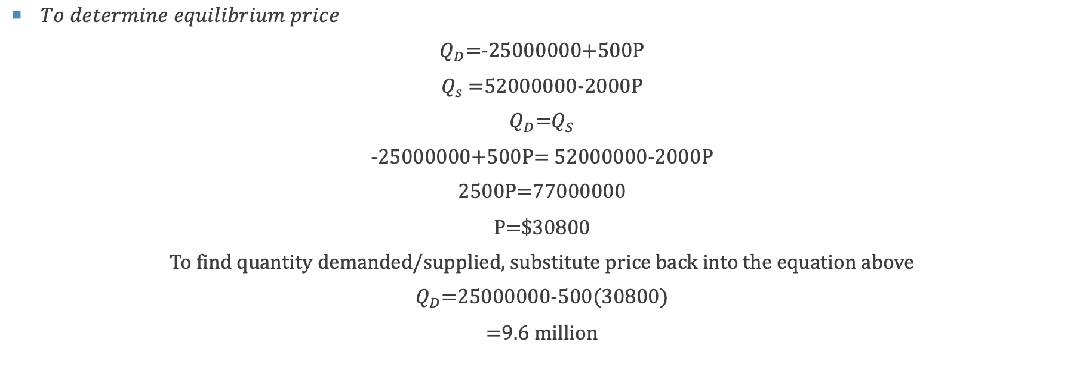
Equilibrium price
$To determine equilibrium price$
$Q_{D}$=-25000000+500P
$Q_{s}$=52000000-2000P
$Q_{D}$=$Q_{S}$
-25000000+500P= 52000000-2000P
2500P=77000000
P=$30800
To find quantity demanded/supplied, substitute price back into the equation above
$Q_{D}$=25000000-500(30800)
=9.6 million

Slide 21
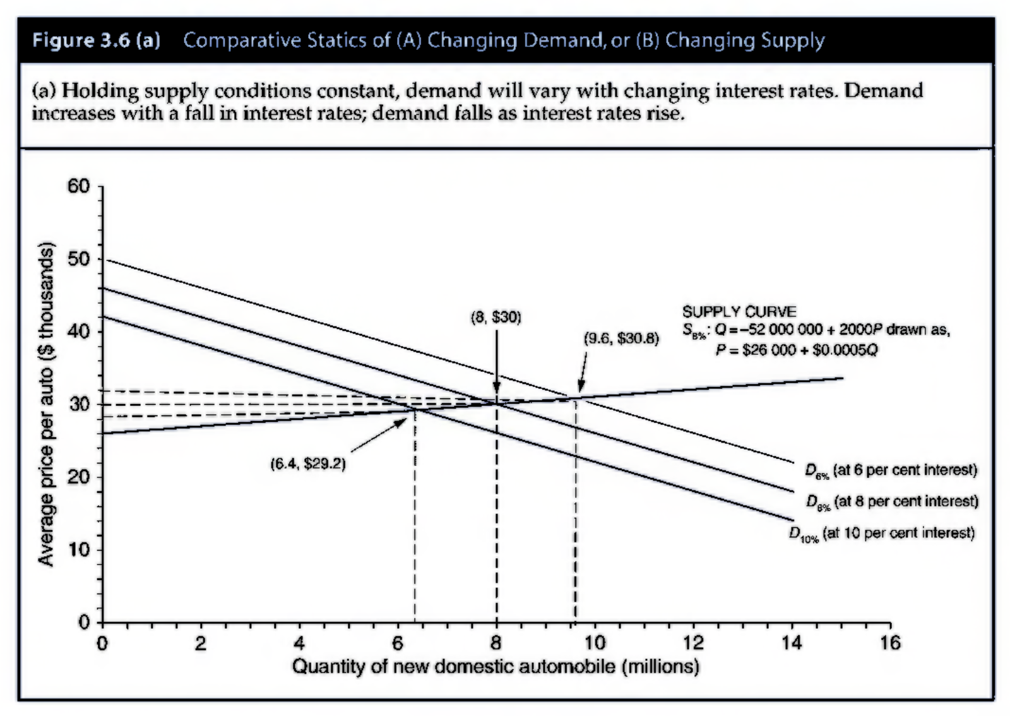
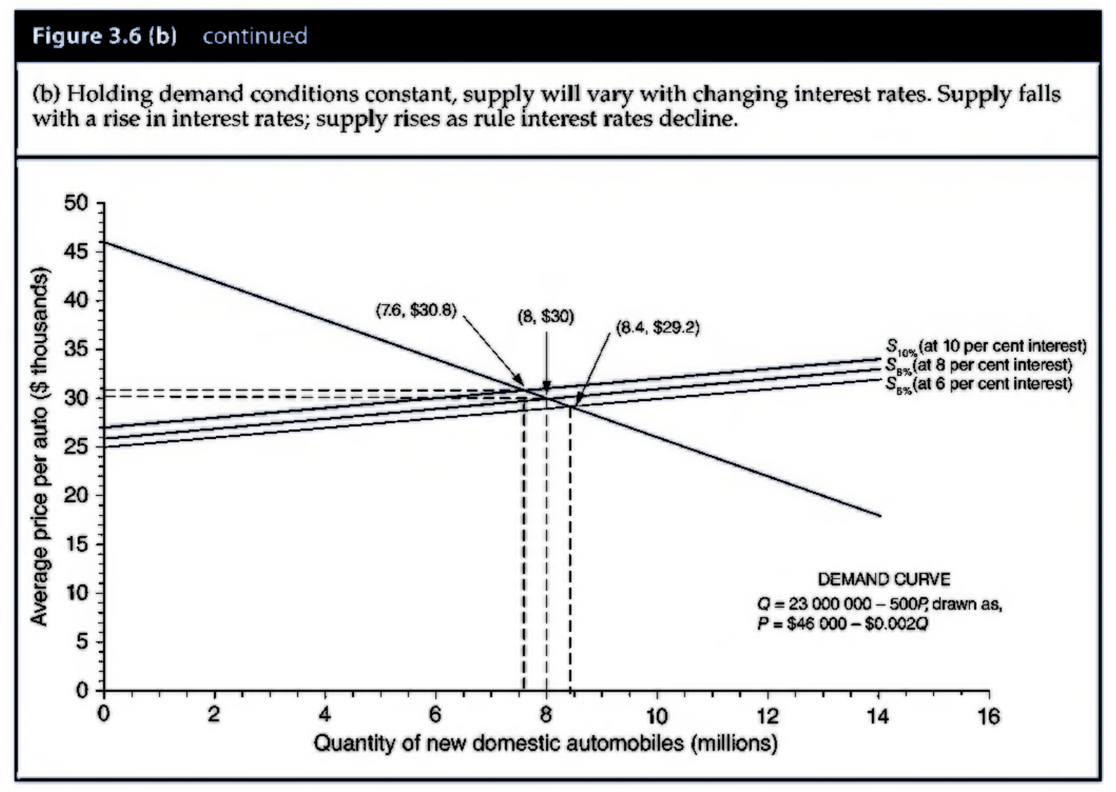
Comparative statics

Slide 22
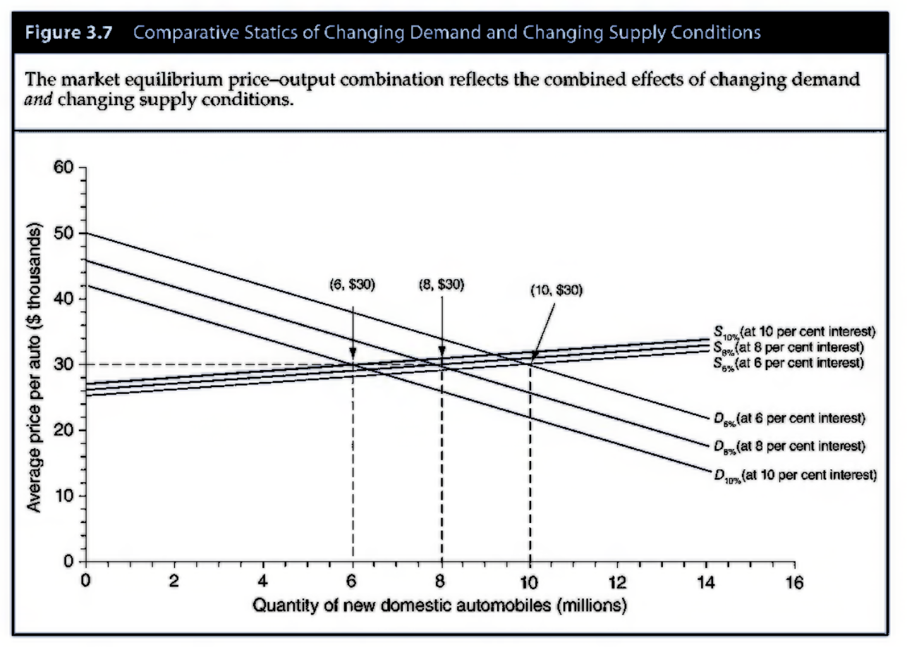
Comparative statics

