Slide 1
Managerial economics
Lecture 3
Chap 2: Economic optimization

Slide 2
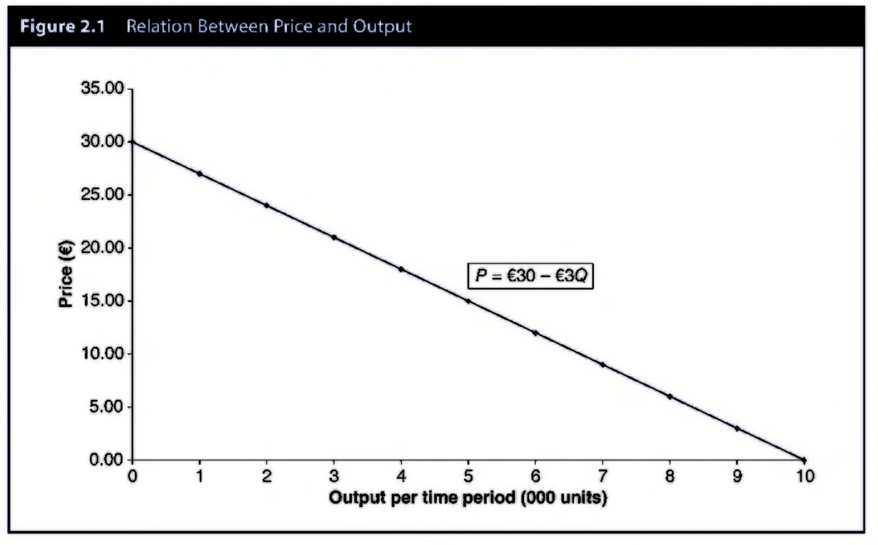
Economic optimization
Optimal Decisions: Choice alternative that produces a result most consistent with managerial objectives
Demand and Total Revenue: TR=f(Q)
TR=PxQ
P=30-3Q
Find TR and MR and revenue maximizing output level and final TR.

Slide 3
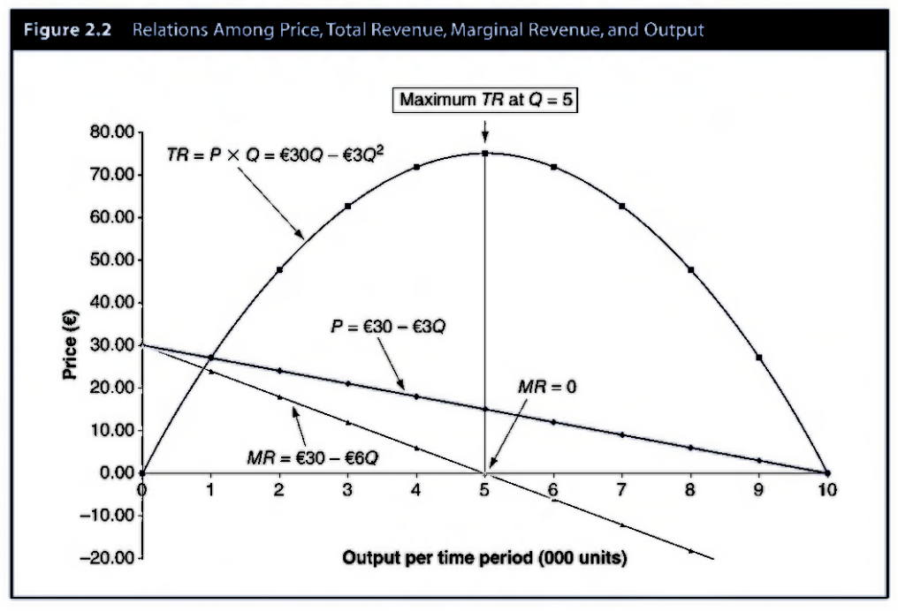
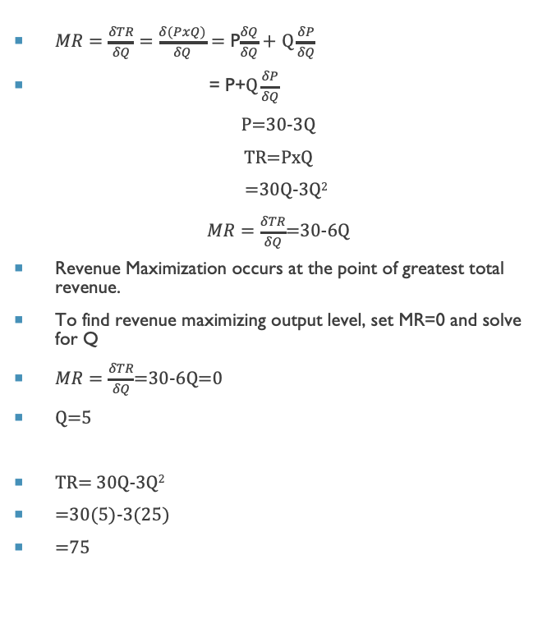
Marginal revenue & revenue maximization
$MR=\frac{δTR}{δQ}=$ $\frac{δ(PxQ)}{δQ}=$ P$\frac{δQ}{δQ}+$ $Q\frac{δP}{δQ}$
= P+$Q\frac{δP}{δQ}$
P=30-3Q
TR=PxQ
=30Q-3Q²
$MR=\frac{δTR}{δQ}$=30-6Q
Revenue Maximization occurs at the point of greatest total revenue.
To find revenue maximizing output level, set MR=0 and solve for Q
$MR=\frac{δTR}{δQ}$=30-6Q=0
Q=5
TR= 30Q-3Q²
=30(5)-3(25)
=75

Slide 4
Cost relations
Cost Function: Relation between cost and output
Short Run Cost Functions: cost relations when fixed costs are present; used for day to day operating decisions
Long Run Cost Functions: cost relation when all costs are variable, used for long-term planning
Short Run: operating period during which availability of at least one input is fixed
Long Run: period of complete flexibility with respect to input use
Total Cost: Fixed Cost + Variable Cost
Fixed Cost: Expenses that do not vary with output. Example: interest expenses, rent on leased plant and equipment, depreciation charges associated with passage of time, property taxes, salaries for employees not laid off during periods of reduced activity.
Variable Cost: Expenses that fluctuate with output. Example: expenses for raw materials, depreciation associated with use of equipment, variable portion of utility charges, some labor costs

Slide 5
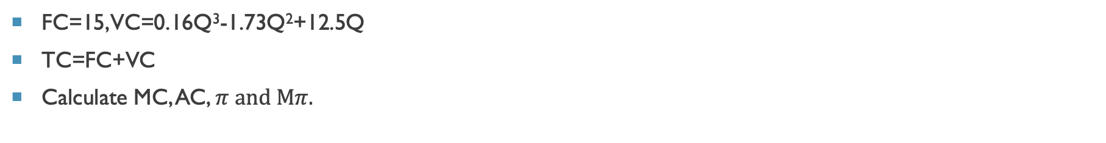
costs
FC=15, VC=0.16Q³-1.73Q²+12.5Q
TC=FC+VC
Calculate MC, AC, $π$ and M$π$.

Slide 6
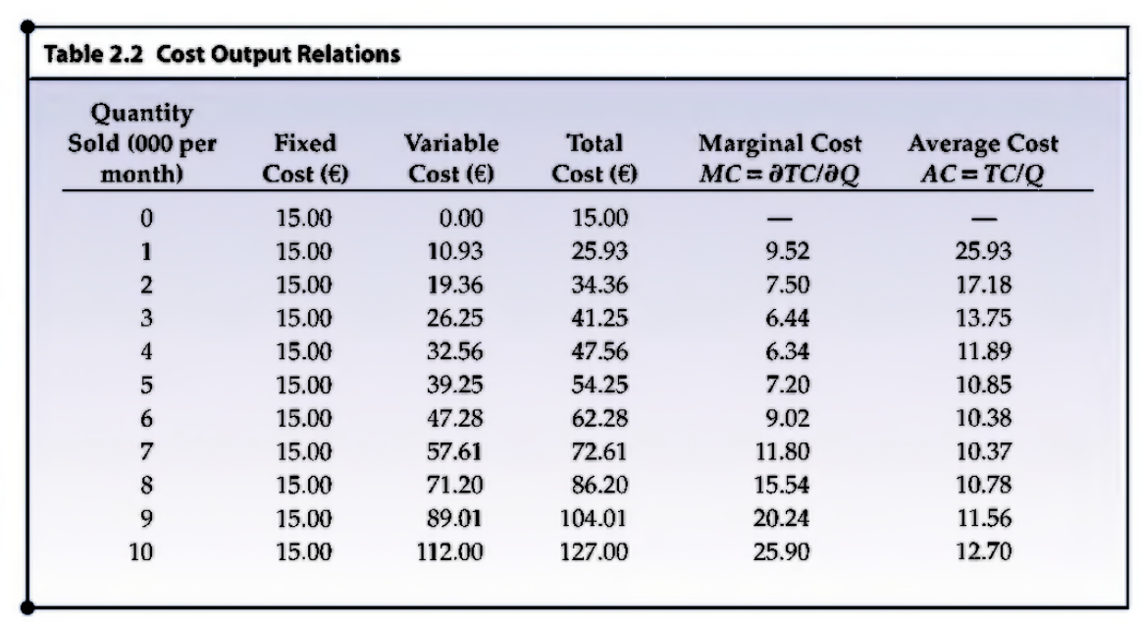
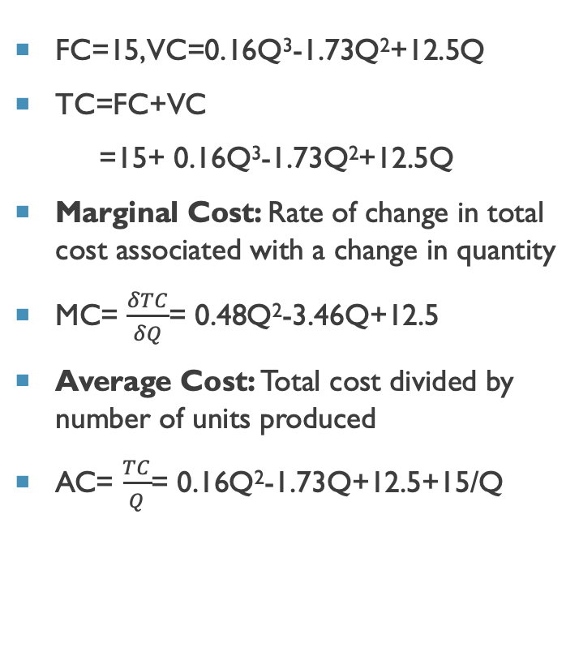
Costs
FC=15, VC=0.16Q³-1.73Q²+12.5Q
TC=FC+VC
=15+ 0.16Q³-1.73Q²+12.5Q
Marginal Cost: Rate of change in total cost associated with a change in quantity
MC= $\frac{δTC}{δQ}$= 0.48Q²-3.46Q+12.5
Average Cost: Total cost divided by number of units produced
AC= $\frac{TC}{Q}$= 0.16Q²-1.73Q+12.5+15/Q

Slide 7
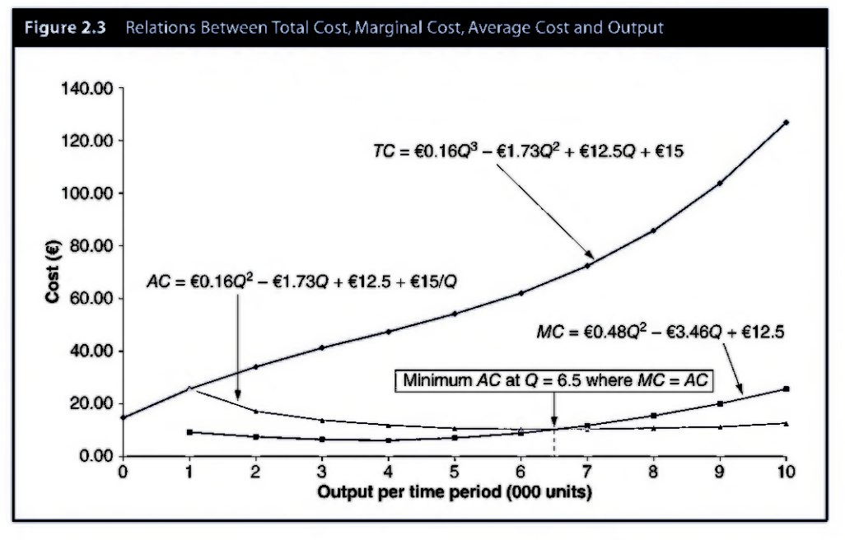
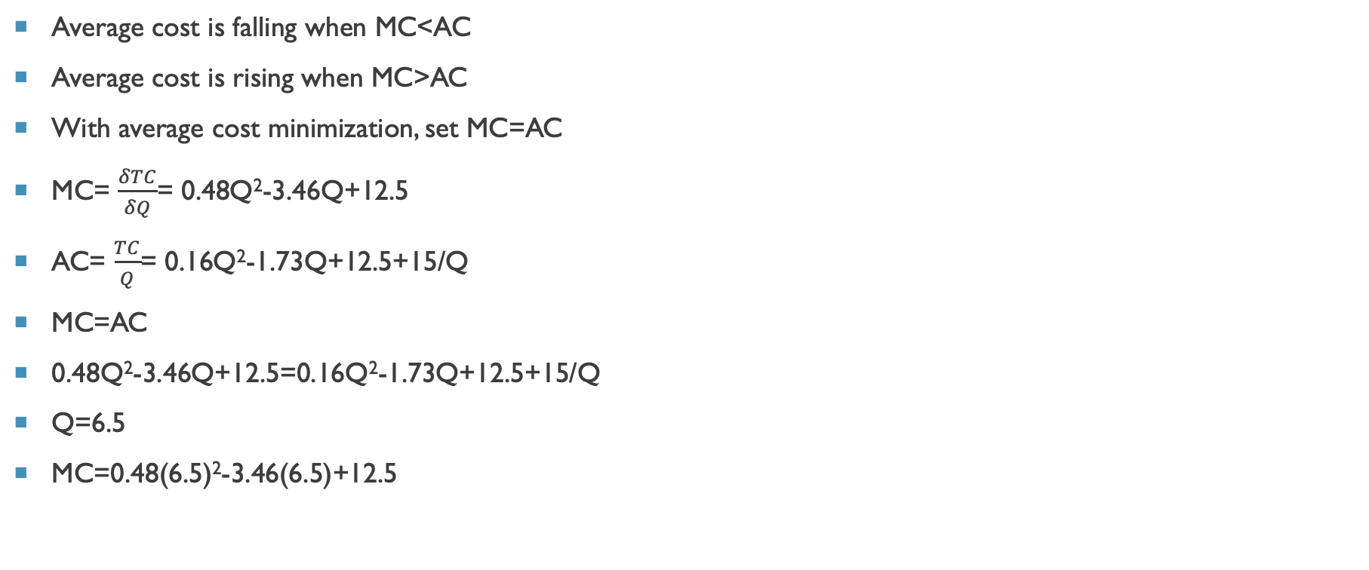
Average cost minimization
Average cost is falling when MC<AC
Average cost is rising when MC>AC
With average cost minimization, set MC=AC
MC= $\frac{δTC}{δQ}$= 0.48Q²-3.46Q+12.5
AC= $\frac{TC}{Q}$= 0.16Q²-1.73Q+12.5+15/Q
MC=AC
0.48Q²-3.46Q+12.5=0.16Q²-1.73Q+12.5+15/Q
Q=6.5
MC=0.48(6.5)²-3.46(6.5)+12.5

Slide 8
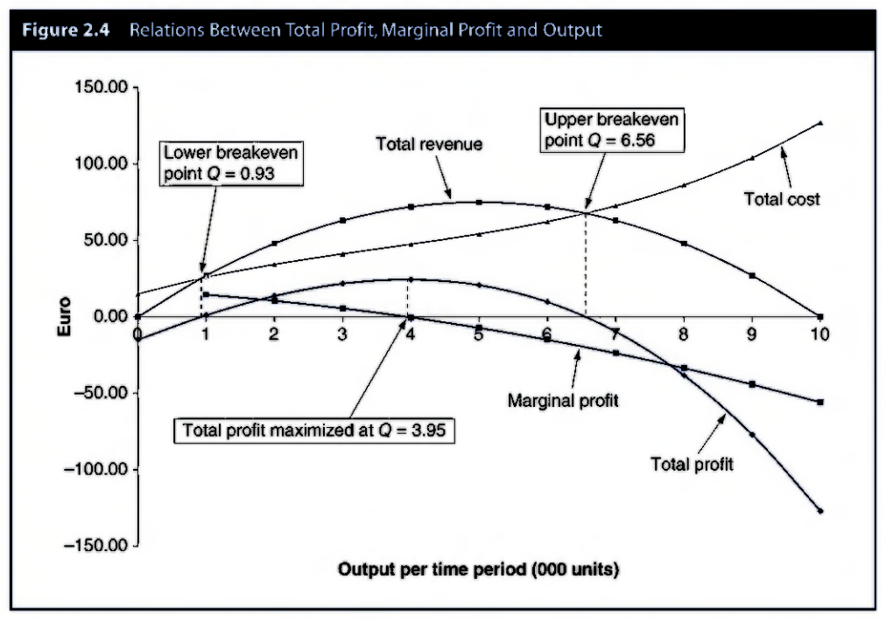

Profit relations
Marginal Profit: $\frac{δπ}{δQ}⇒$M$π$=MR-MC
Profit is maximized when M$π=0 →MR=MC$
$π=TR−TC$
=(30Q-3Q²)-(15+ 0.16Q³-1.73Q²+12.5Q)
= -0.16Q³-1.27Q²+17.5Q-15
M$π=MR−MC$
=(30-6Q)-(0.48Q²-3.46Q+12.5)
= -0.48Q²-2.54Q+17.5
Setting M$π=0,$-0.48Q²-2.54Q+17.5=0
Q=3.95
Plug this into $π$ to get profit
$π\text{= −0.16}\text{(3.95)}\text{3}\text{−1.27}\text{(3.95)}\text{2}\text{+17.5}\text{(3.95)}\text{−15}$
=24.45

