Slide 1
Managerial economics
Lecture 1

Slide 2
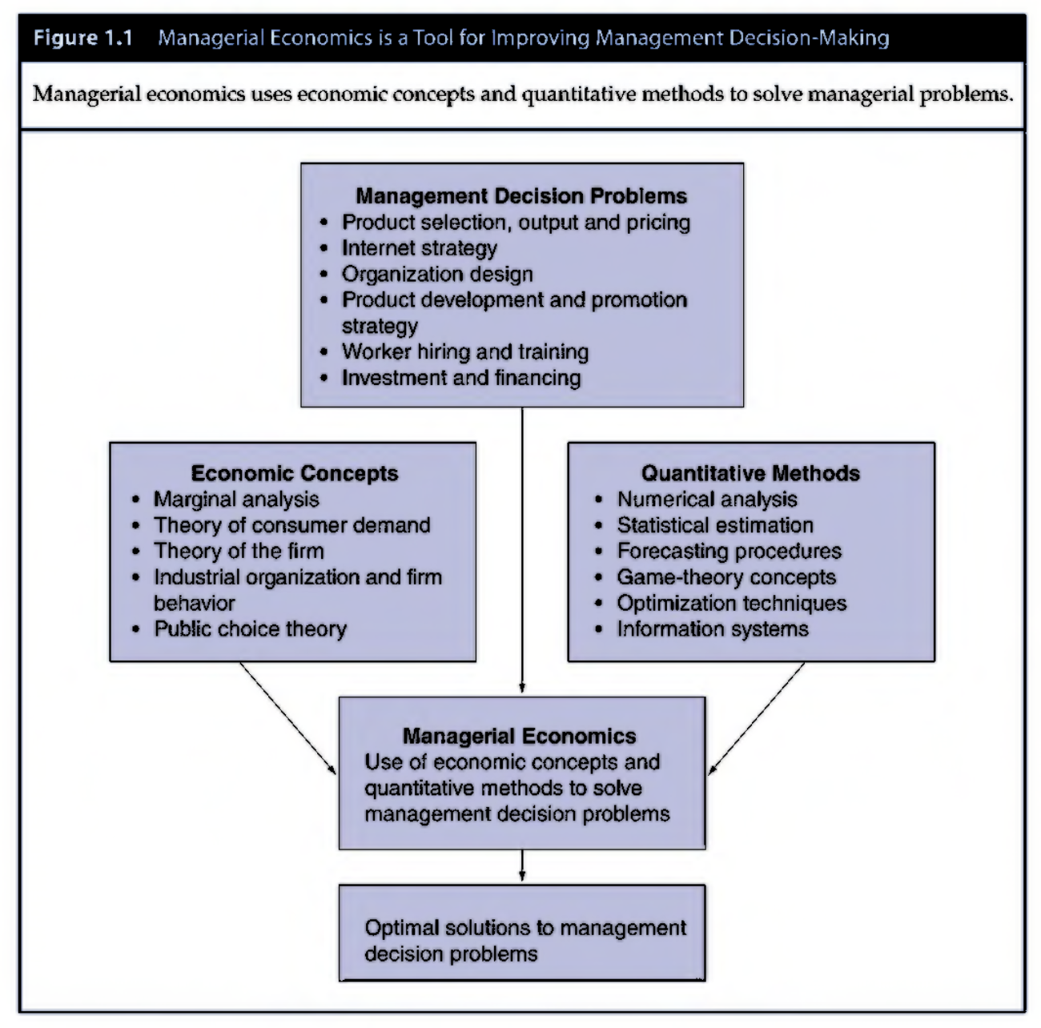
introduction
Managerial Economics: helps managers recognize how economic forces affect organizations and describes the economic consequences of managerial behavior.
It links economic concepts, data and quantitative methods to develop vital tools for managerial decision-making.
Evaluating Choice Alternatives
It identifies ways to achieve goals efficiently
It provides production and marketing rules that permit company to maximize net profits once it has achieved growth or market share objectives.
Making the Best Decision
It offers comprehensive application of economic theory and methodology to management decision-making.

Slide 3
Theory of firm
Theory of Firm: Basic model of business with a firm having profit maximization as its main goal
Firms are useful for producing and distributing goods and services
Expected Value Maximization
Business enterprise: series of contractual relationships that specify the rights and responsibilities of various parties.
People involved include customers, stockholders, management, employees and suppliers.
Society is also included as businesses use scarce resources, pay taxes, provide employment and produce society’s material and services output.
The business model is called the Theory of Firm
Firm: main objective is profit maximization and long term expected value maximization.

Slide 4
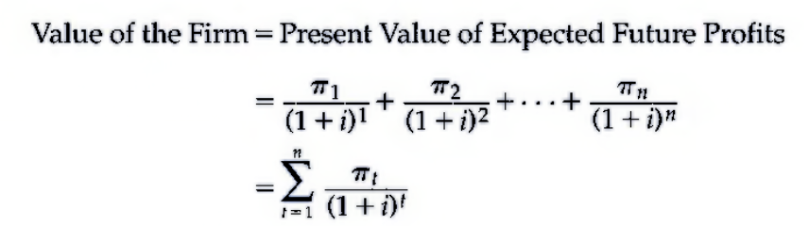
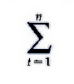
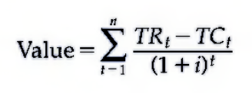
Value of firm
Value of Firm: Present value of firm’s expected profits discounted back to present at an appropriate interest rate
This is done because future cash flows are less valuable than current ones
Profits earned in future years are discounted to reflect the time value of money-$1 earned today is worth more than one earned in future
Summing this up, we get:
Because profits=Total Revenue-Total Cost

Slide 5
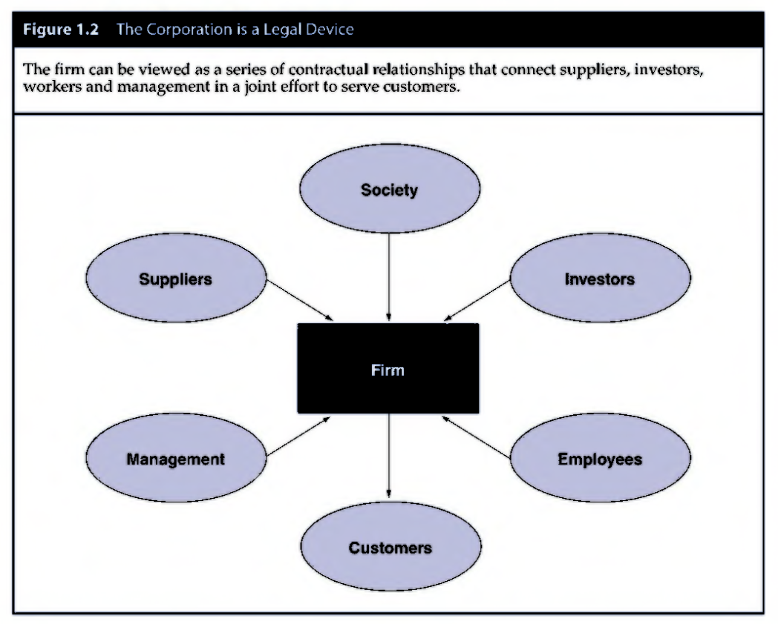
Theory of firm
Relationship between expected value maximization and firm’s functional departments
Marketing Department: promotion and sales
Production Department: development costs
Finance Department: acquires capital and determines discount factor in denominator
Constraints and Theory of Firm
Constraints faced by firm include availability of inputs including skilled labor, raw materials, energy, machinery and warehouse space.
Legal restrictions can also play an important role in managerial decisions.

Slide 6
Profit measurement
Business vs Economic Profit
Business Profit: Sales Revenue-Explicit Costs of doing business. It is the amount available to fund equity capital after payment to all other resources used by the firm
This is usually measured as a percentage of sales revenue called profit margin
Economic Profit: Business Profit-Implicit (Noncash) Costs of Capital and Other Owner-Provided Inputs used by firm
Owner inputs including entrepreneurial effort and capital must also be compensated for. Economist includes normal rate of return on equity capital+ opportunity cost for effort of owner-entrepreneur
This is usually measured as return on stockholders’ equity (ROE). This is accounting net income divided by book value of firm

Slide 7
Why do profits vary among firms?
Disequilibrium Profit Theories
Frictional Profit Theory: Markets are sometimes in disequilibrium because of unanticipated changes in demand or cost conditions
Unanticipated shocks produce positive or negative economic profits for some firms.
Monopoly Profit Theory: extension of frictional profit theory
Above normal profits caused by barriers to entry that limit competition
Unlike other above normal profits, monopoly profits are often seen as unwarranted and subject to heavy taxes or otherwise regulated.
Compensated Profit Theories
Innovation Profit Theory: Above normal profits that follow successful invention or modernization
Compensated Profit Theory: Above normal rates of return that reward efficiency
Above normal profits serve as a valuable signal that a firm’s output should be increased. These reward innovation and efficiency.
Expansion by firms or entry by new competitors occurs quickly during high profit periods
Below normal profits signal need for contraction and exit. They penalize stagnation and inefficiency.

Slide 8
Role of business in society
Why Firms Exist
Firms exist to serve social needs.
What goods and services should be produced? How should these be produced and distributed?
However, they may also conspire with one another in setting prices or restricting output to obtain higher profits and reduce social welfare.
Solution: regulation and imposition of antitrust laws

Slide 9
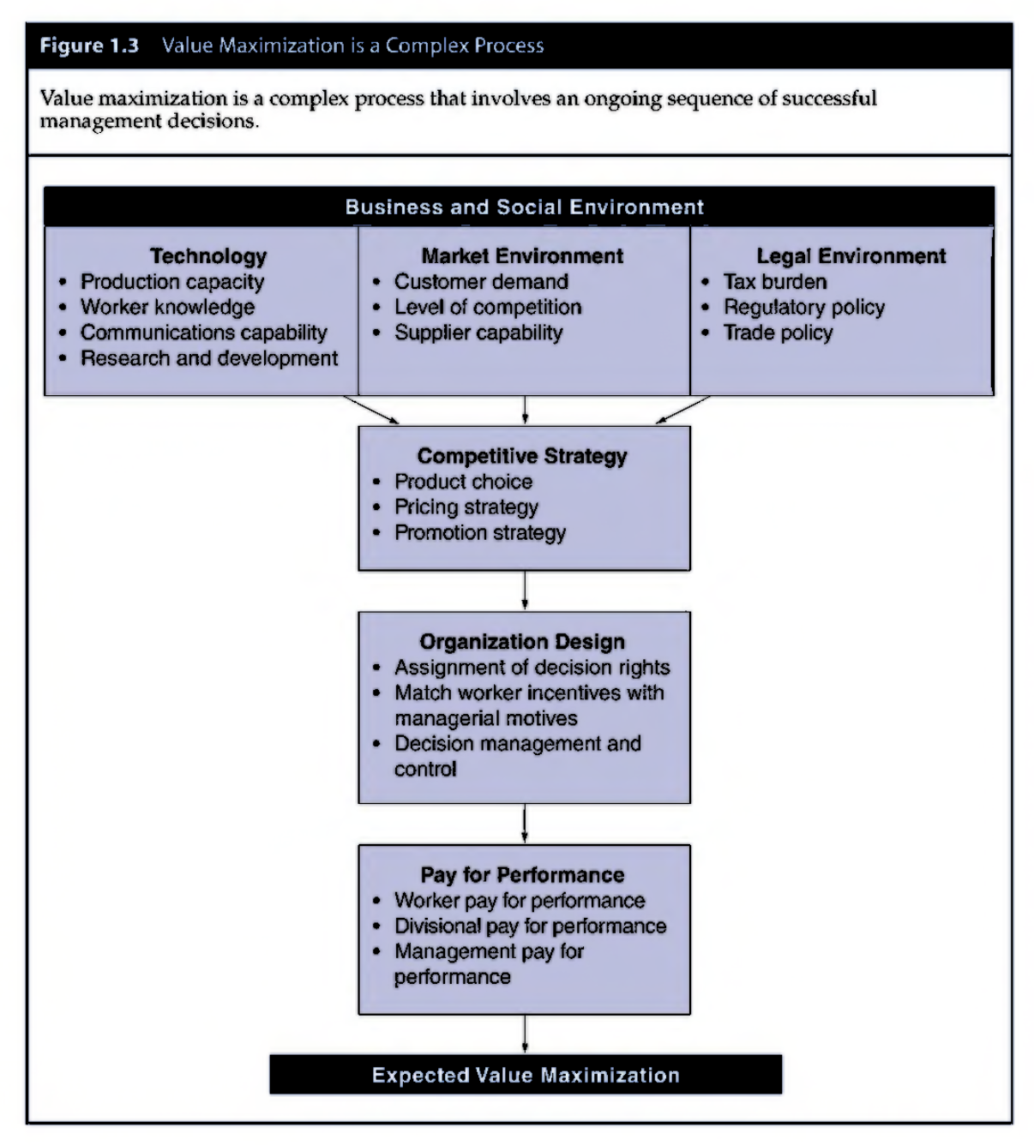
Social responsibility of business

Slide 10
Case study: Is Coca-Cola the ‘Perfect’ Business?
Coca-Cola: nonalcoholic to ensure widespread appeal among both young and old; cold to provide relief from heat, should have a trademark name, adding sugar to gain food value and act as positive stimulant
Advertising: associate beverage with happiness and make it available in sporting events, concerts, beach and theme parks
Enjoys large and growing profits, almost entire value derived from advertising.

